Slide 1
Community change over time:
functional traits and abundance variation of algae and animals from Appledore Island
Kate Sheridan, Jenny Muñoz, Laura Super, Ellen K. Bledsoe, Andrea Brown, Julien Beaulieu, Jennifer A. Dijkstra, Amelia Hesketh, Nicole Knight, Jake Lawlor, Alexis Pereira, Tianna Peller, Kylla M. Benes, Jarrett E. K. Byrnes

Slide 2
Biodiversity change Ecosystem function
Change in marine biodiversity has been documented on every shoreline
Taxonomic diversity -- Species, Genera, Families -- frequently used to measure biodiversity change
What does biodiversity and ecosystem change mean for the organisms living in a specific location?
Other measures measures of diversity connect taxonomic change to shifts in ecosystem functioning
Notes:
Credits : https://www.jpl.nasa.gov/edu/images/activities/chlor_sea_temp.gif
‘We know the communities are changing taxonomically; are they also changing functionally’

Slide 3
Functional traits
Morphological or ecological traits influencing survival of organisms.
Demonstrates ecosystem function; Can be tracked through time
Nutrient storage
Body size
Nutrient transport
Dietary preference
Ecosystem stability
Dispersal
Trophic regulation
Life span
Community shaping
Notes:
Traits—-- can be link to a function in the ecosystem

Slide 4
Challenging to use functional traits!
- Lack of a single, comprehensive trait database
- Best functional trait data can be laborious to collect: measuring many individuals in region of interest
- Long term datasets essential to see effects

Slide 5
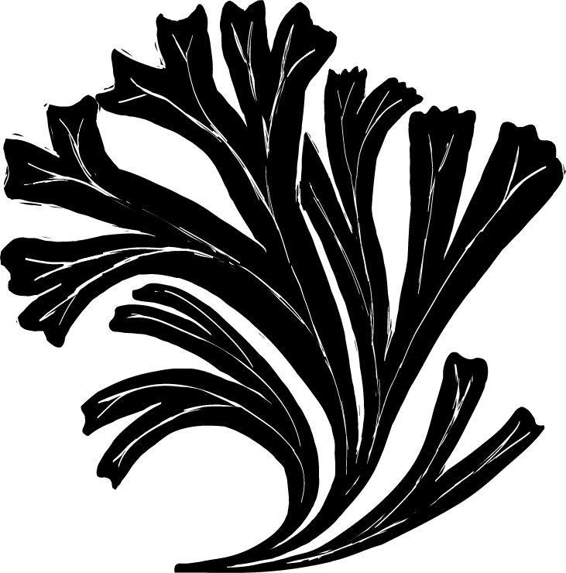
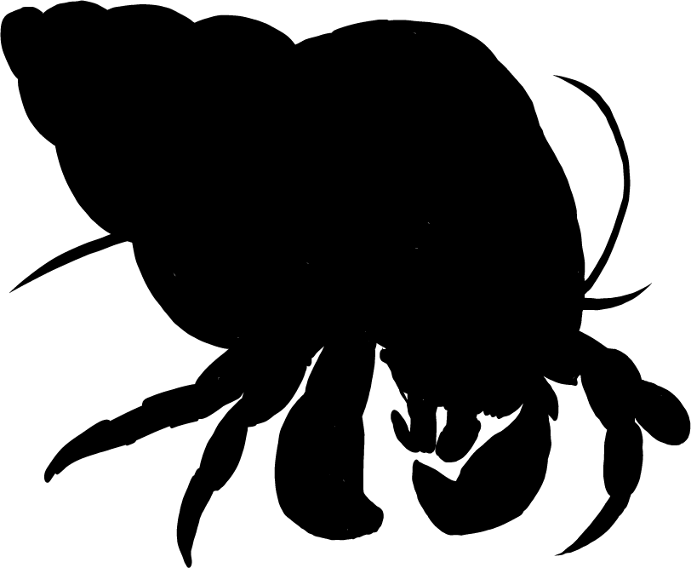
Dataset: Appledore Island intertidal community
Ongoing inventory of intertidal communities from Appledore Island in the Gulf of Maine (40 years)
Algae and marine invertebrate count and percent cover data were recorded
Traits were not recorded

Slide 6
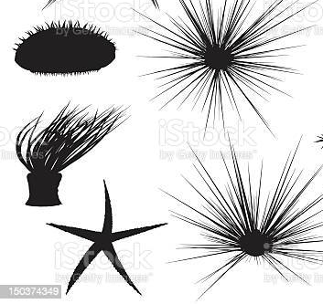



Our trait database
Growth form / External morphology | How is it shaped? | Nutrient transportation / storage
Vertical space use | Is it on the top or the bottom? | Nutrient transportation / storage
Body size | How big are adults? | Nutrient transportation / storage
Feeding | How/Who does it eat? | Nutrient storage, trophic regulation
Sociality | Does it live alone or together? | Community shaping
Motility | Can adults move? | Community shaping
Notes:
We compiled a species-traits that represents species performance and fitness in marine ecosystems.

Slide 7
Our trait database
Body size | How big are adults? | Nutrient transportation / storage
Feeding | How/Who does it eat? | Nutrient storage, trophic regulation
Sociality | Does it live alone or together? | Community shaping
Motility | Can adults move? | Community shaping
Growth form / External morphology | How is it shaped? | Nutrient transportation / storage
Vertical space use | Is it on the top or the bottom? | Nutrient transportation / storage
Notes:
We compiled a species-traits that represents species performance and fitness in marine ecosystems.

Slide 8
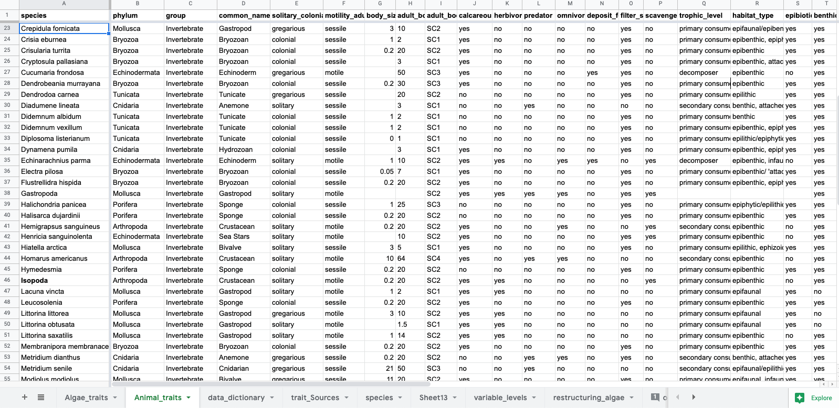
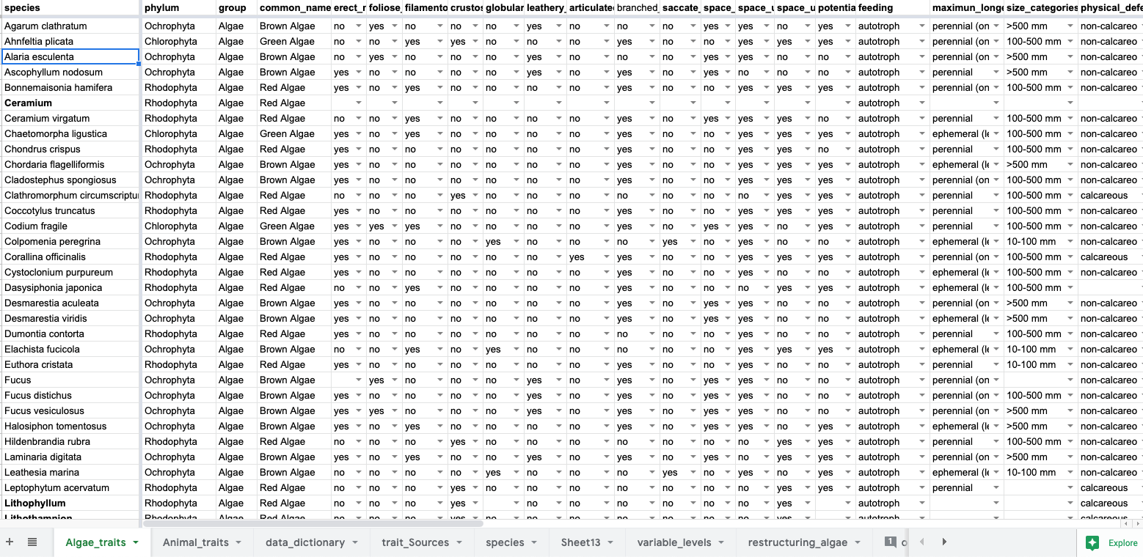
Our trait database
Notes:
We compiled a species-traits that represents species performance and fitness in marine ecosystems.

Slide 9
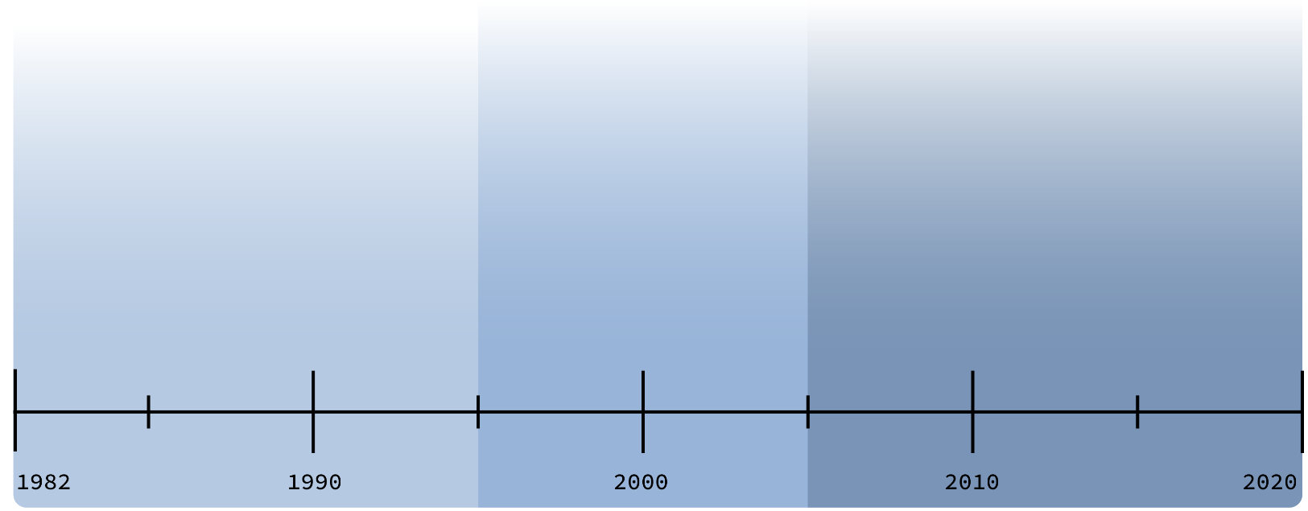
Community changes on Appledore Island
Urchin barrens
Urchins reduced
Cod collapse
Mesopredator rise
Red algae rise
Red algae dominant
Data Slice 1
Data Slice 2
Data Slice 3
Notes:
This will support how we make the decision for timeframes ( some time frames are going to be 10 years others maybe 13 years) and we will need to specify how we made those decisions.

Slide 10
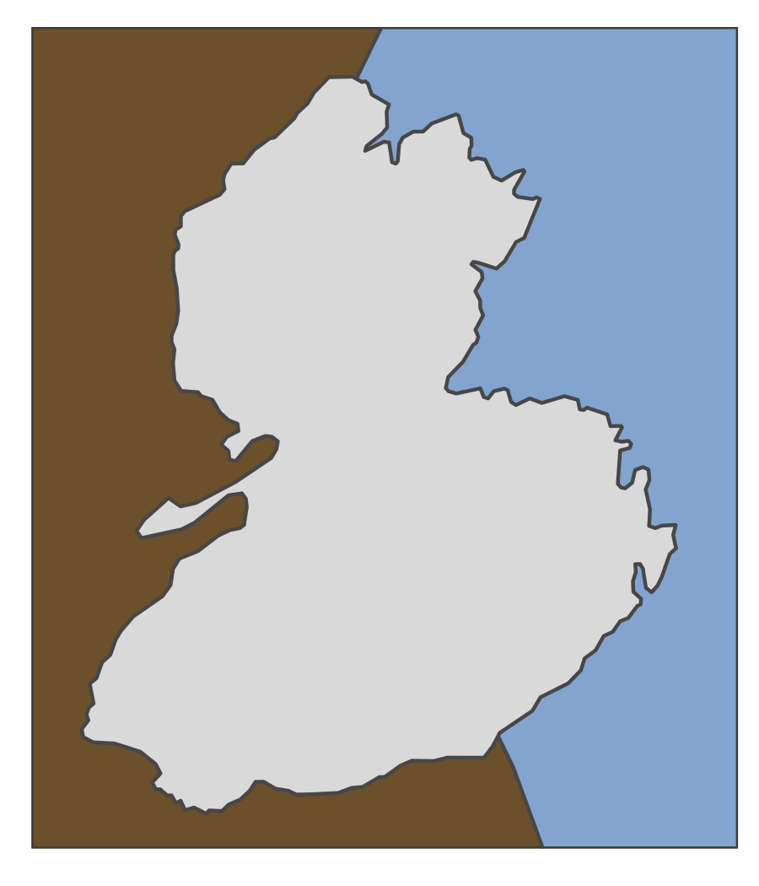
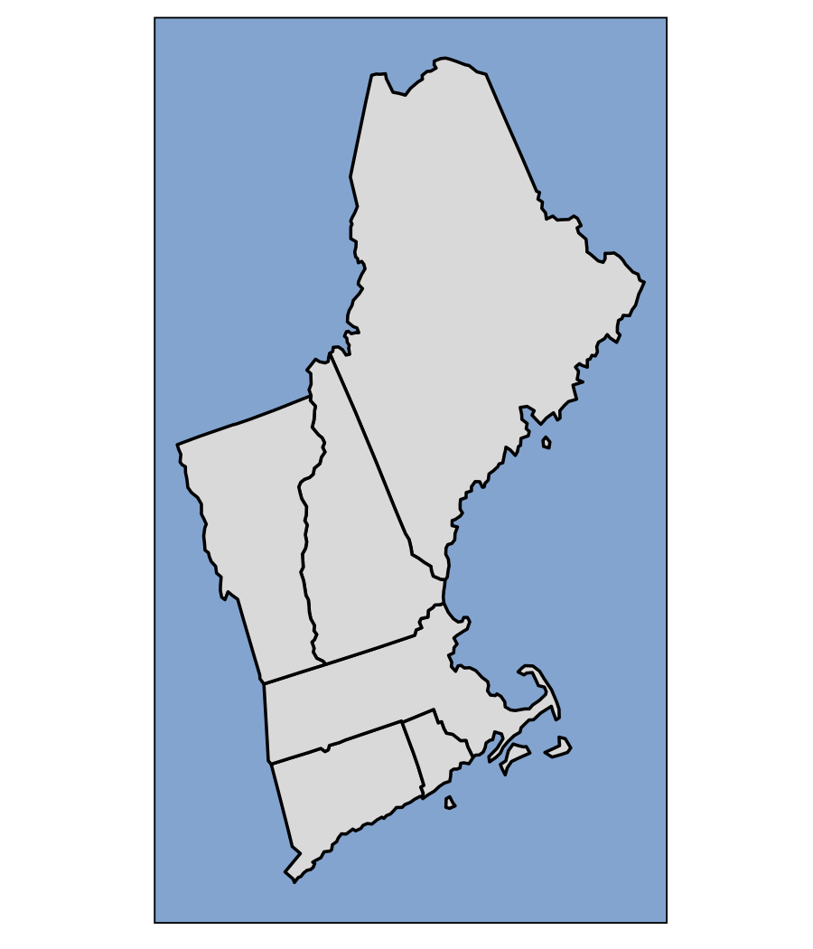
Appledore Island: Exposure
Protected
from the
open ocean
Exposed
to the
open ocean
Notes:
From Jareth presentation

Slide 11
Dataset splits:
Red & filamentous algae
Urchins
Mesopredators
Notes:
Expectations from each:
Algae: not much is eating algae but littorina; can shelter predators in the lower intertidal and inverts from extreme weather in upper intertidal.

Slide 12
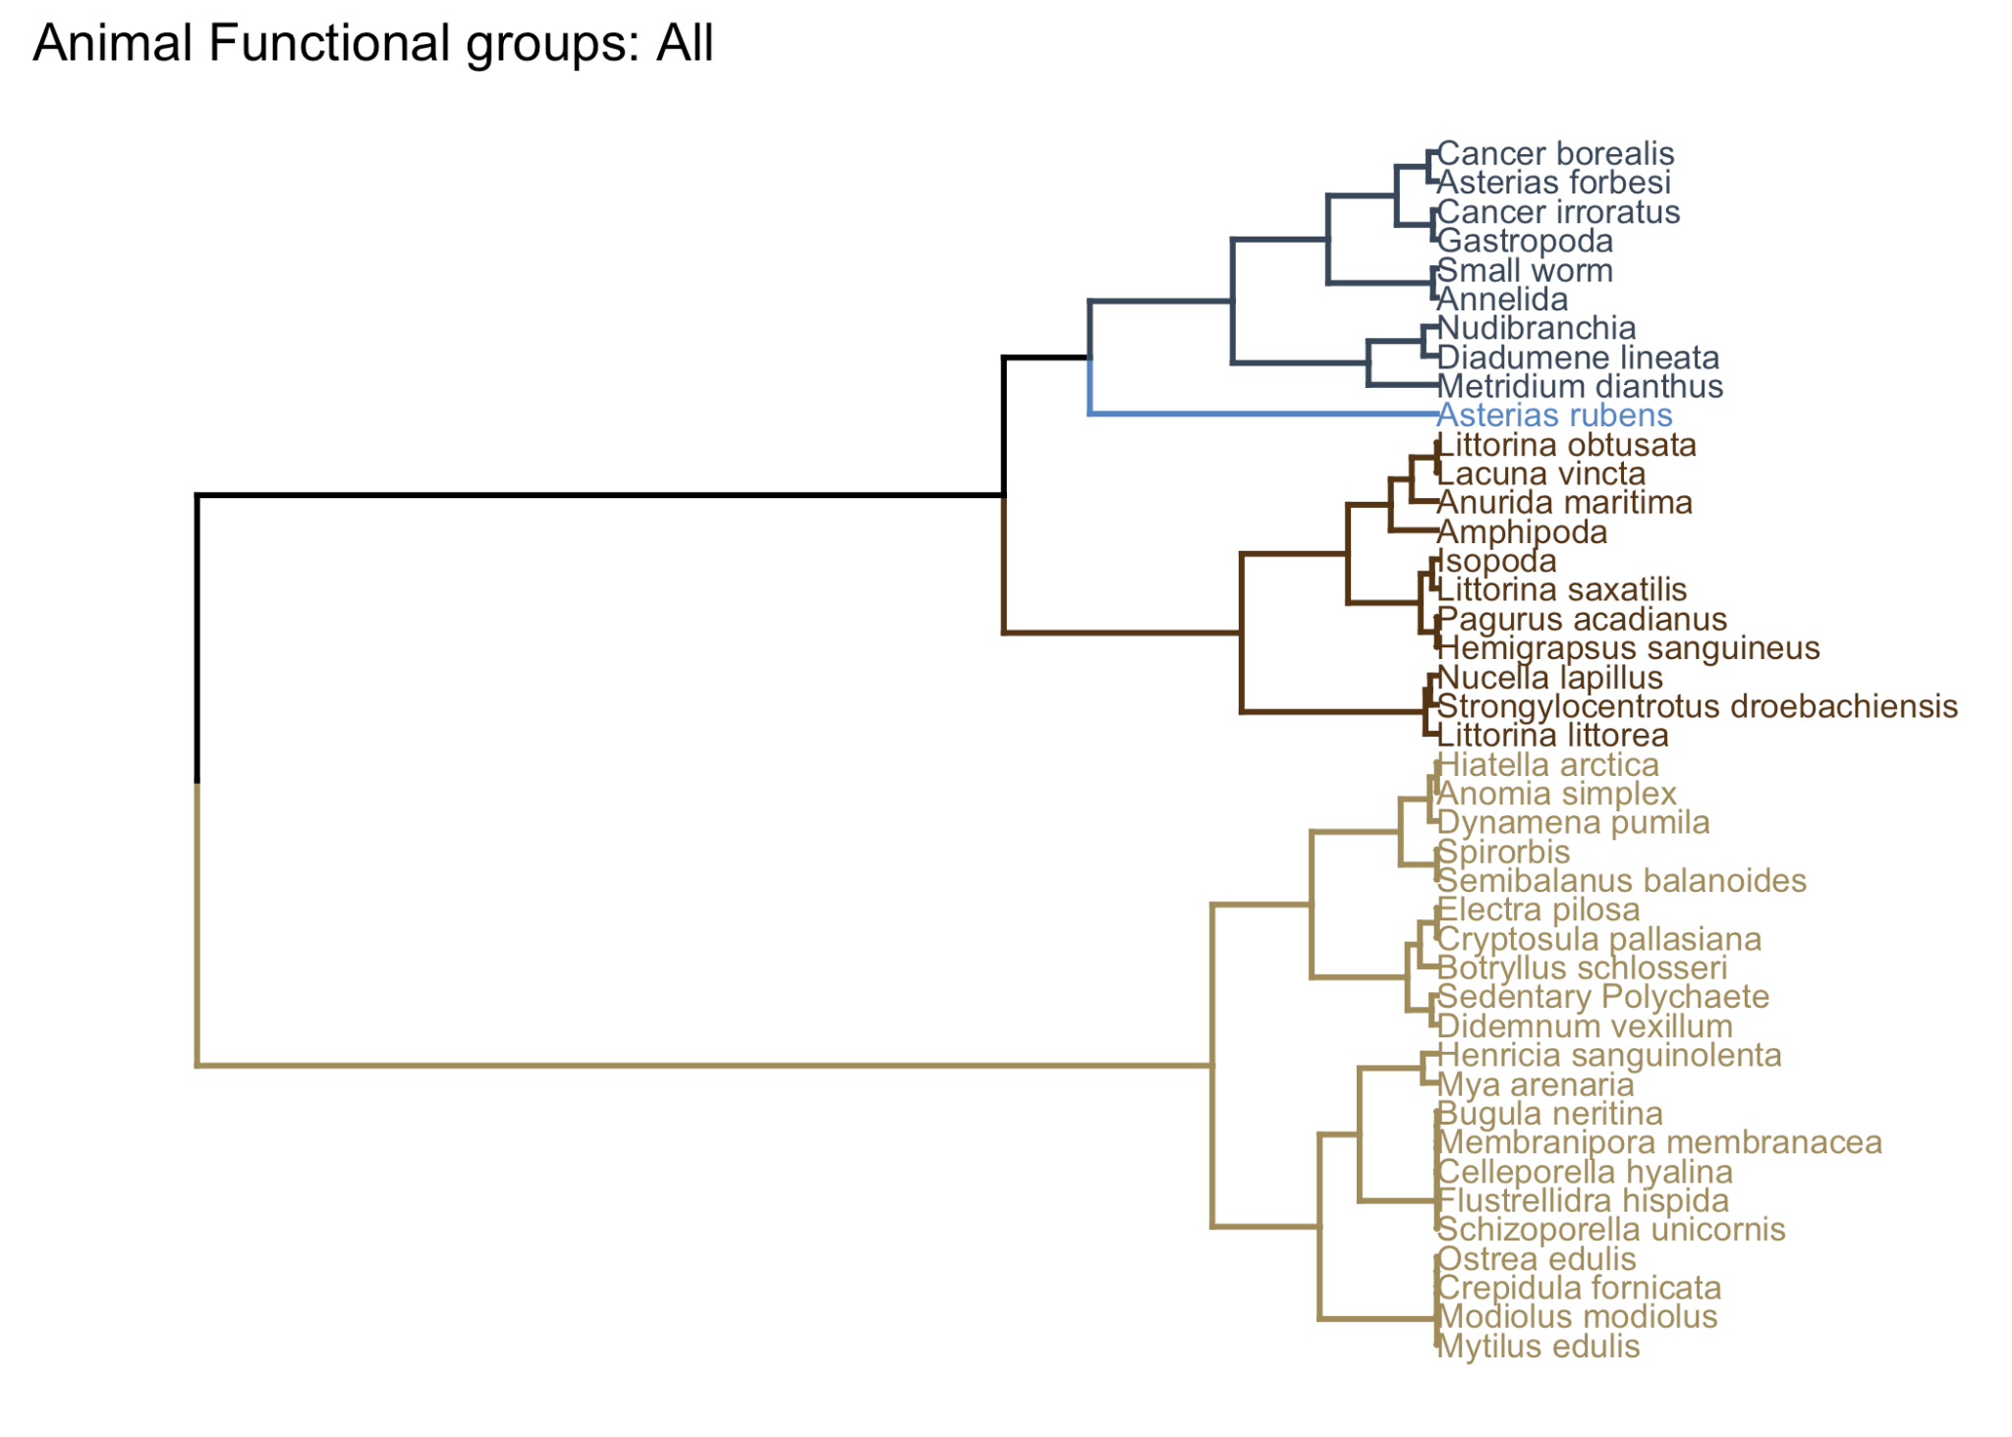
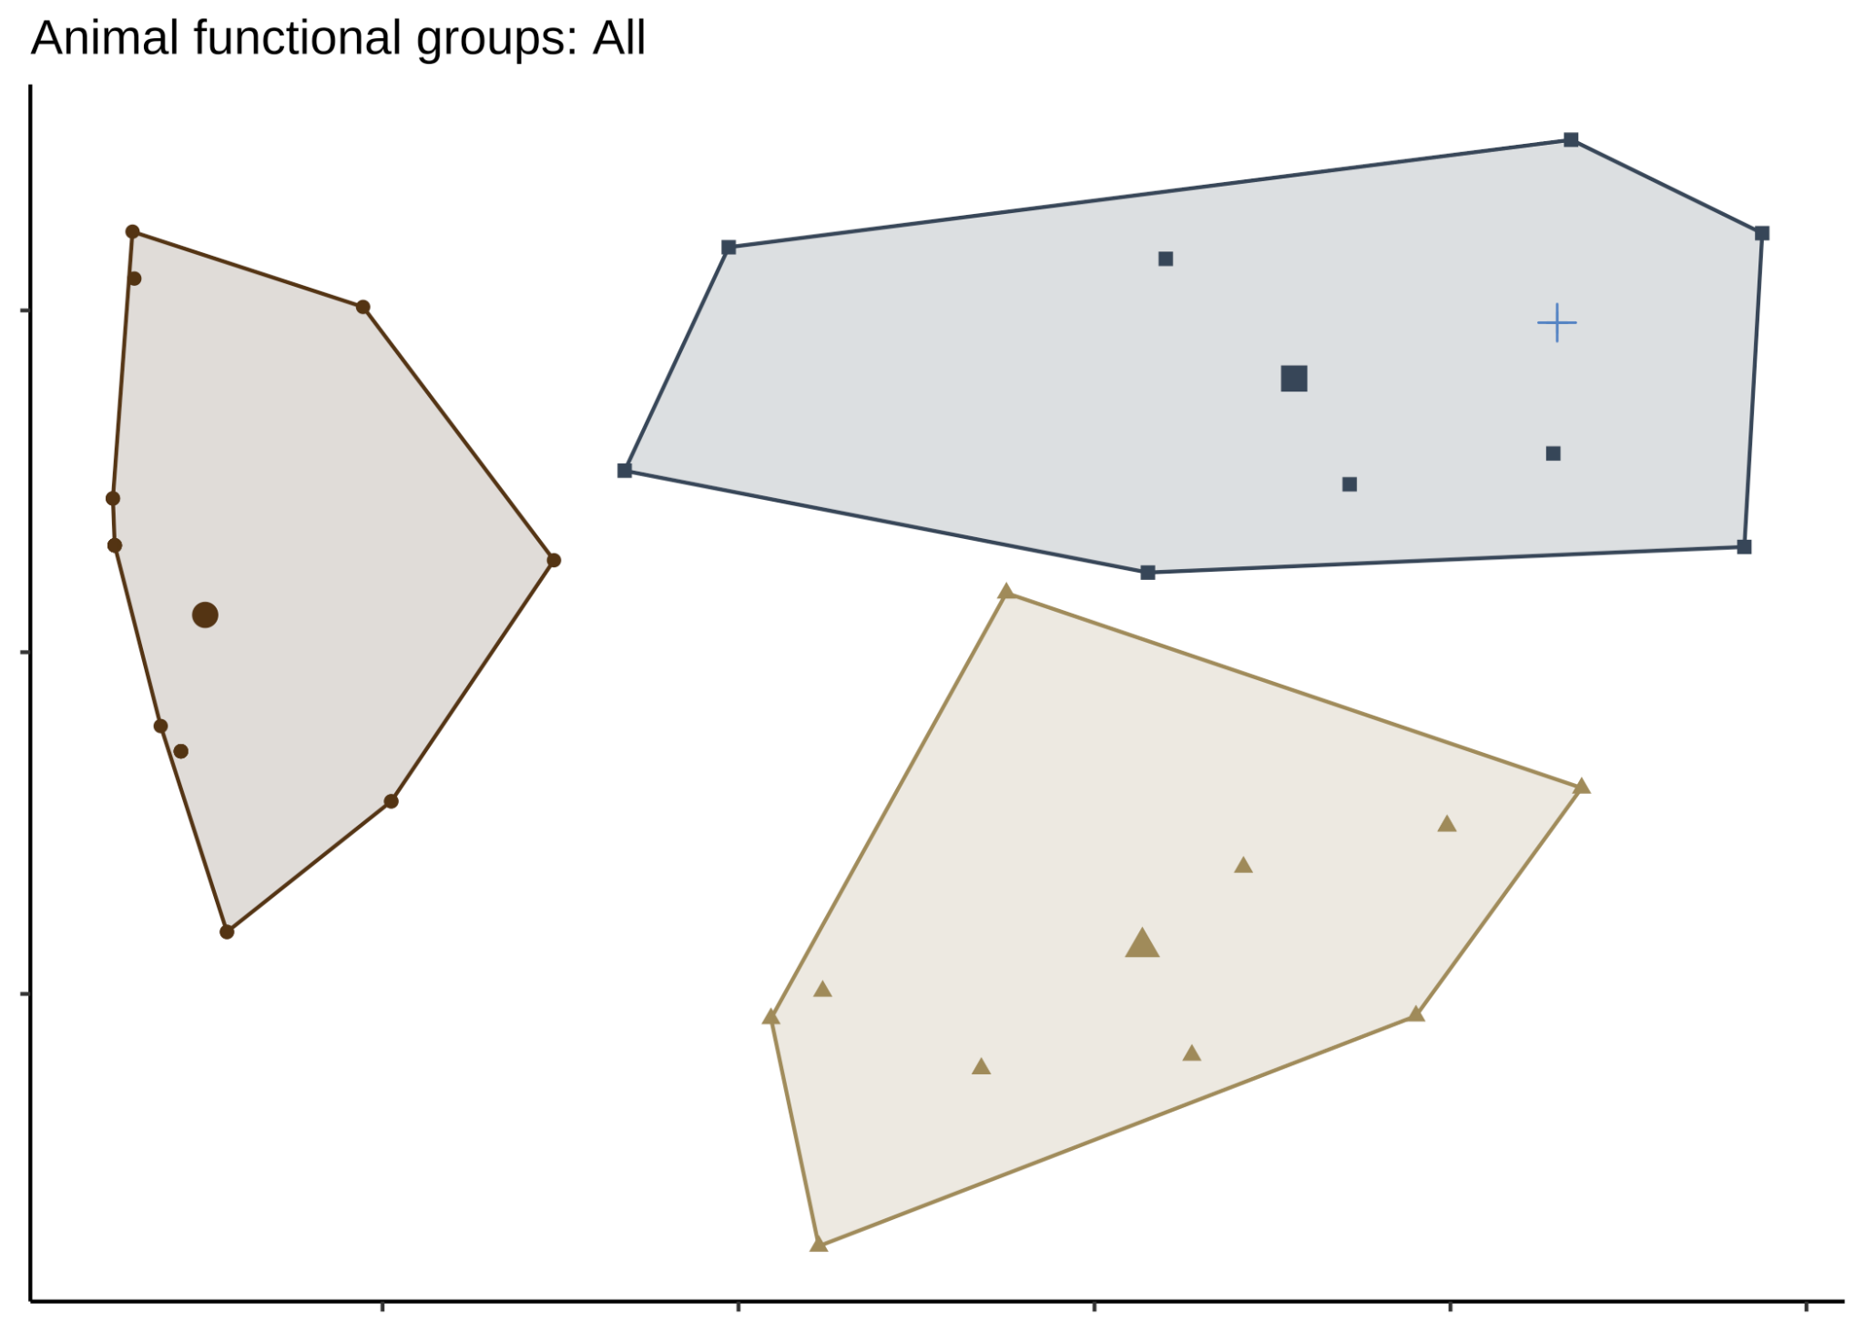
Functional groups: Animals
Mobile, solitary, scavengers and predators
Very large predator
Gregarious, grazers and scavengers, tend to live on other organisms
Sessile filter feeders,
tend to be colonial or gregarious
(not a phylogeny; hierarchical clustering on principal components with traits)
Notes:
Redo cluster colors ah shit
Four functional groups in animals; defined primarily by feeding methods
Laura suggestion: Not for the presentation, but for papers, have animals be shades of grey to orange (so mixed). I just think having the algae being different colours than the animals and also picking colours that are common for those groups helps with visual analytics like congruence :)!

Slide 13
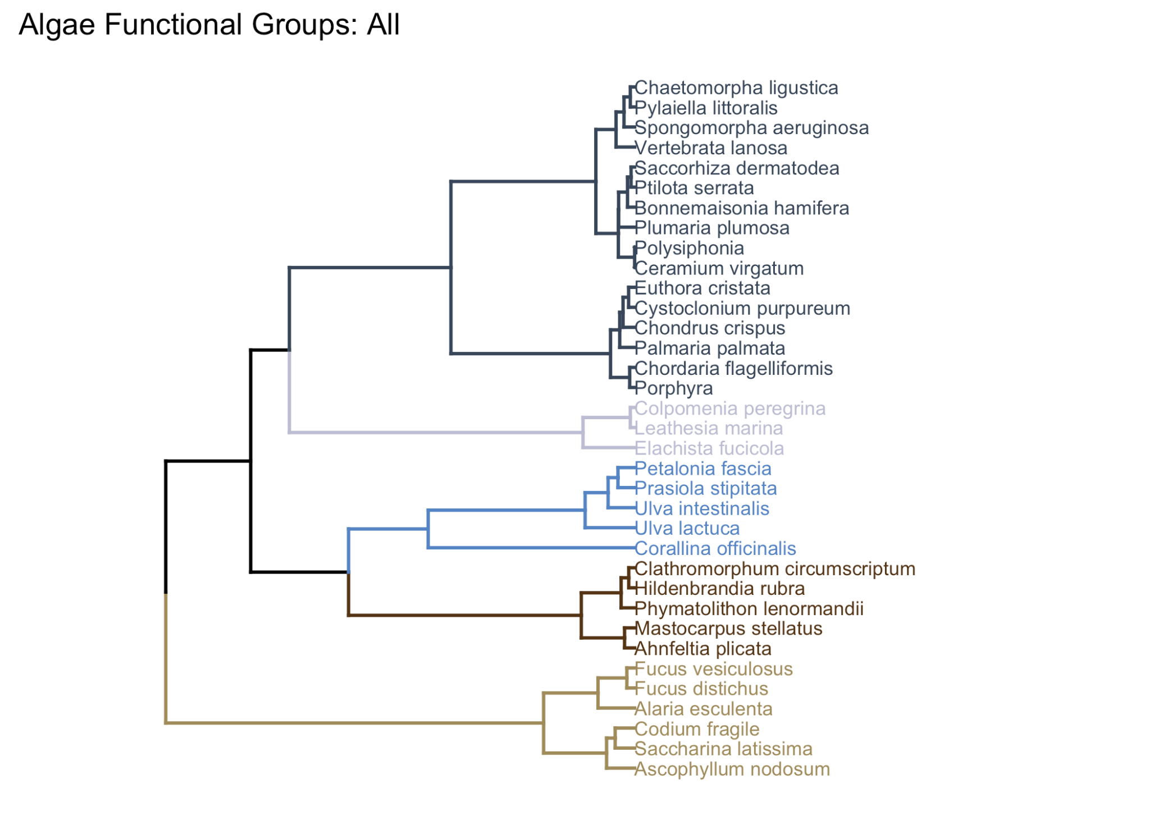
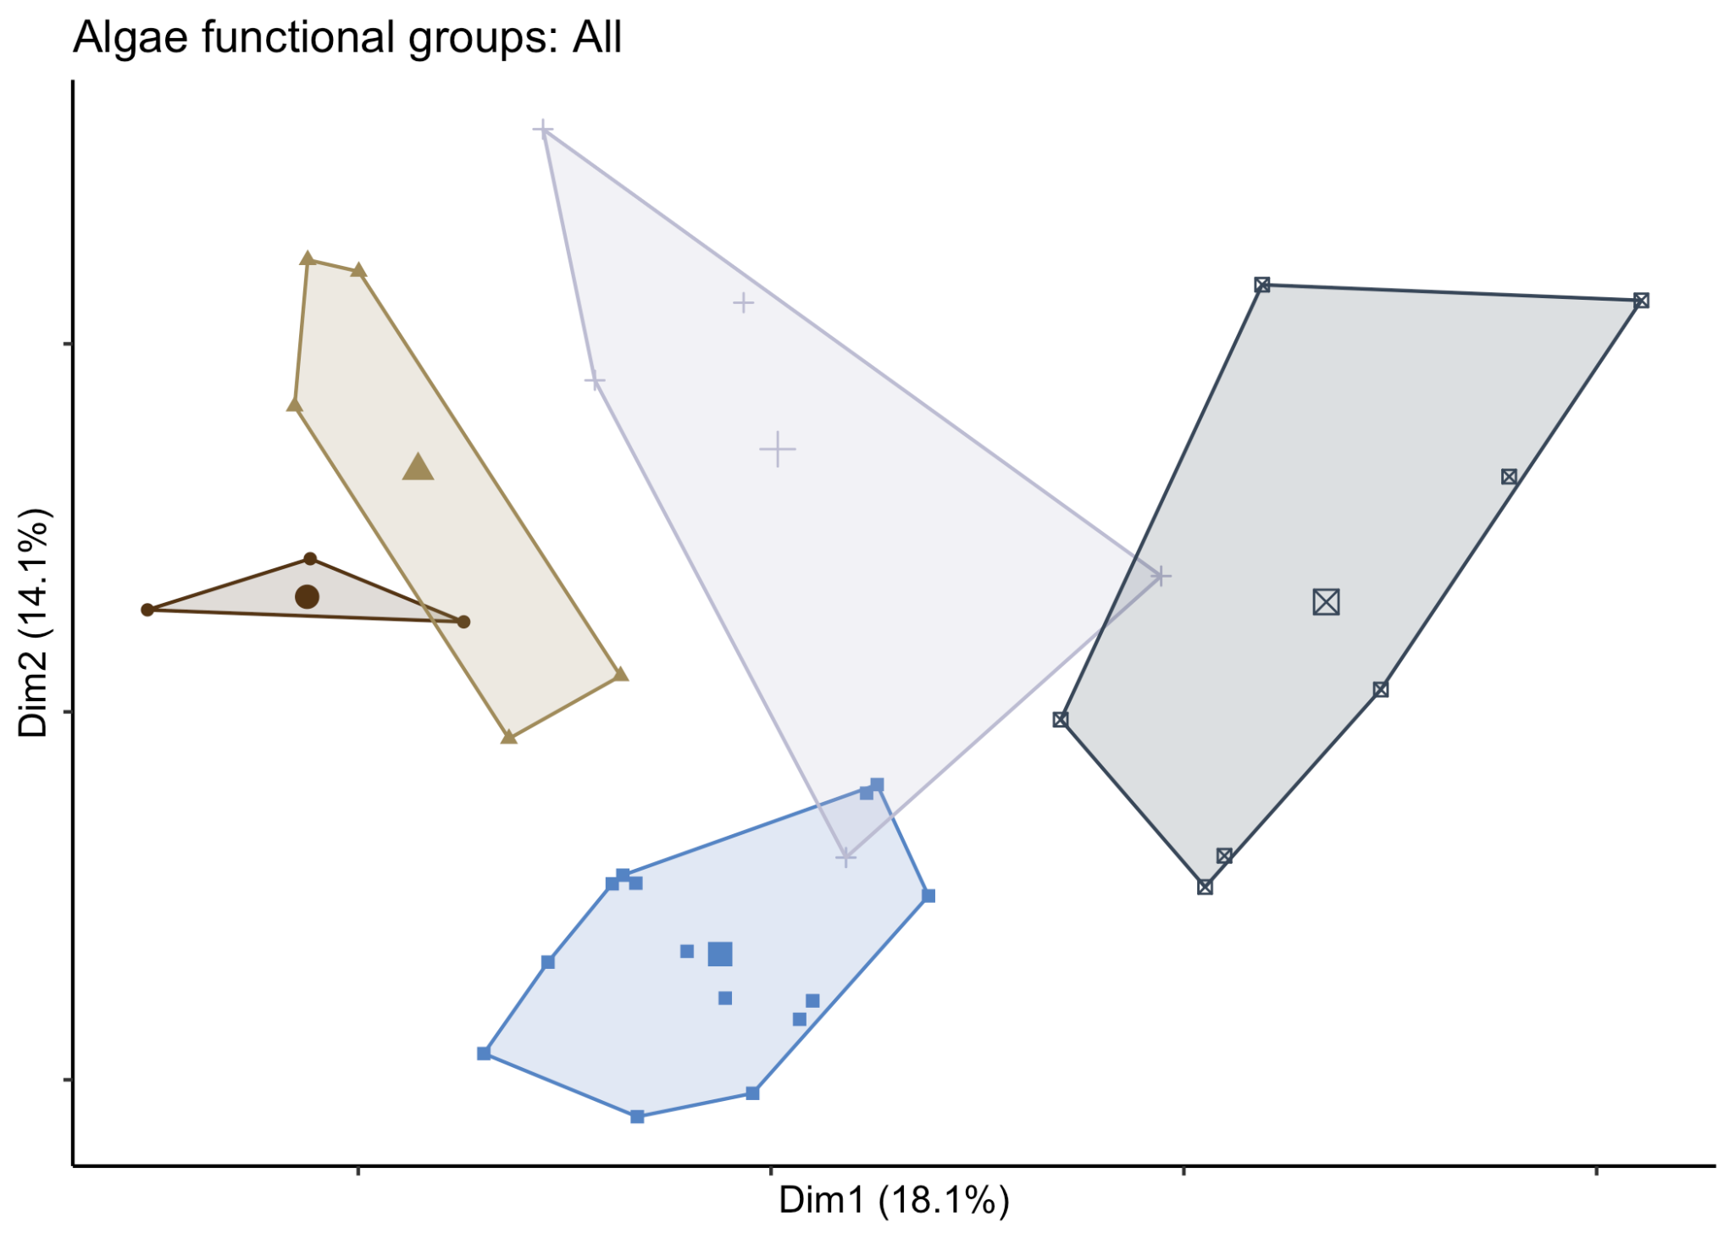
Functional groups: Algae
Branched, foliose, or filamentous
Globular, can be ephemeral
Never subtidal, foliose or articulated
Crustose, potential asexual reproduction
Leathery, canopy, perennial
(not a phylogeny; hierarchical clustering on principal components with traits)
Notes:
Five clusters of algae
Laura suggestion: maybe for the paper have algae be in shades of green to brown?

Slide 14
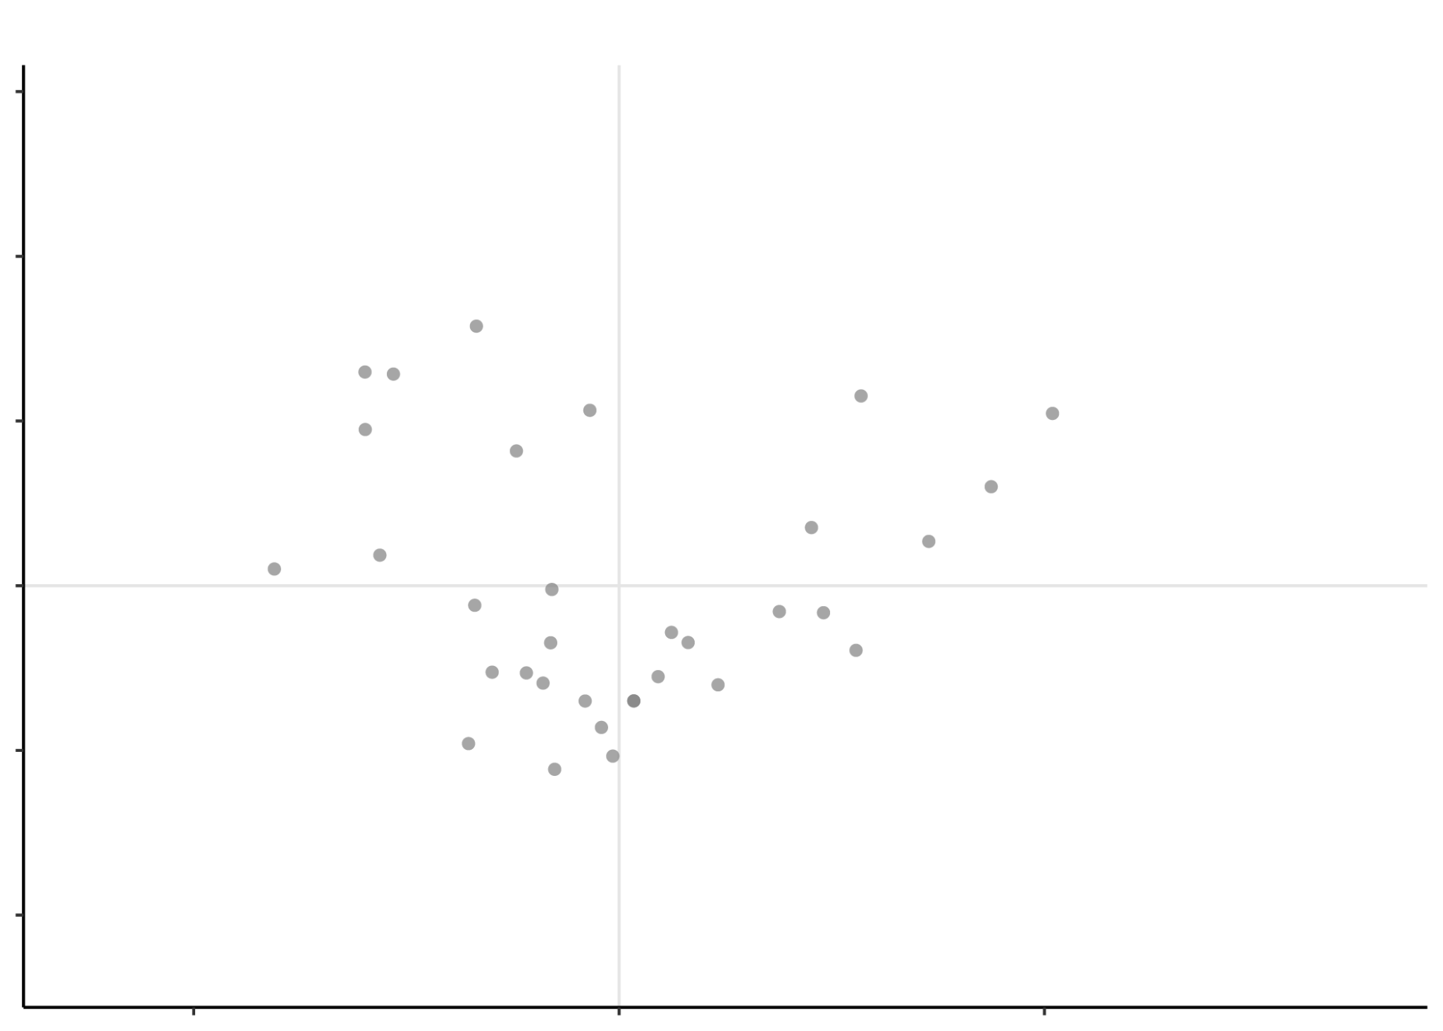
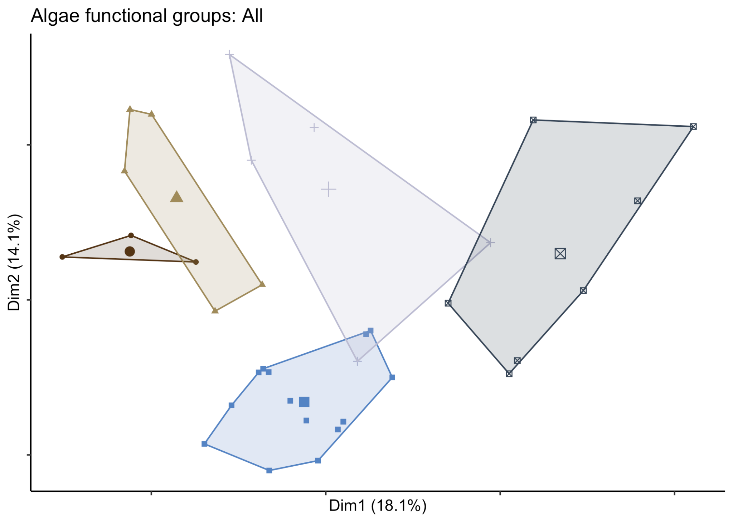
Functional trait fingerprints
Points from Multiple Correspondence Analysis (MCA) plotted directly in ‘trait space’ show individual taxa
Shapes are delineated within trait space to describe the size, position and geometry of the system.
Notes:
this concept assumes that a system can be characterised by a set of independent axes, e.g. functional traits, resource requirements, or abiotic tolerances. These axes constitute an n-dimensional Euclidean space. A geometrical shape can then be delineated within this space and used to describe the size, position and geometry of the system.

Slide 15
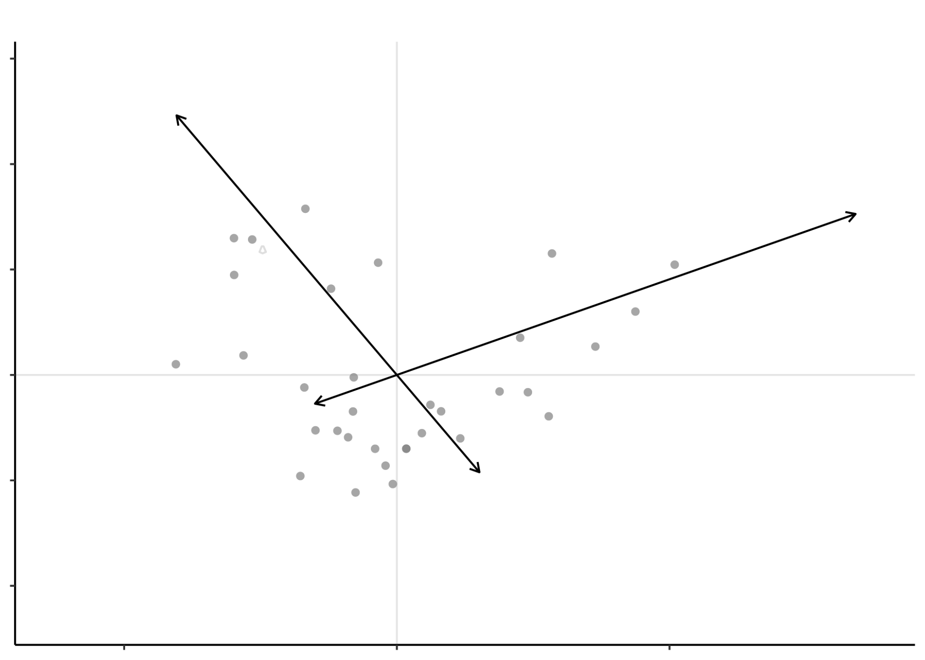
Functional trait fingerprints
Vector lengths show how much a trait value impacts the shape
Notes:
this concept assumes that a system can be characterised by a set of independent axes, e.g. functional traits, resource requirements, or abiotic tolerances. These axes constitute an n-dimensional Euclidean space. A geometrical shape can then be delineated within this space and used to describe the size, position and geometry of the system.

Slide 16
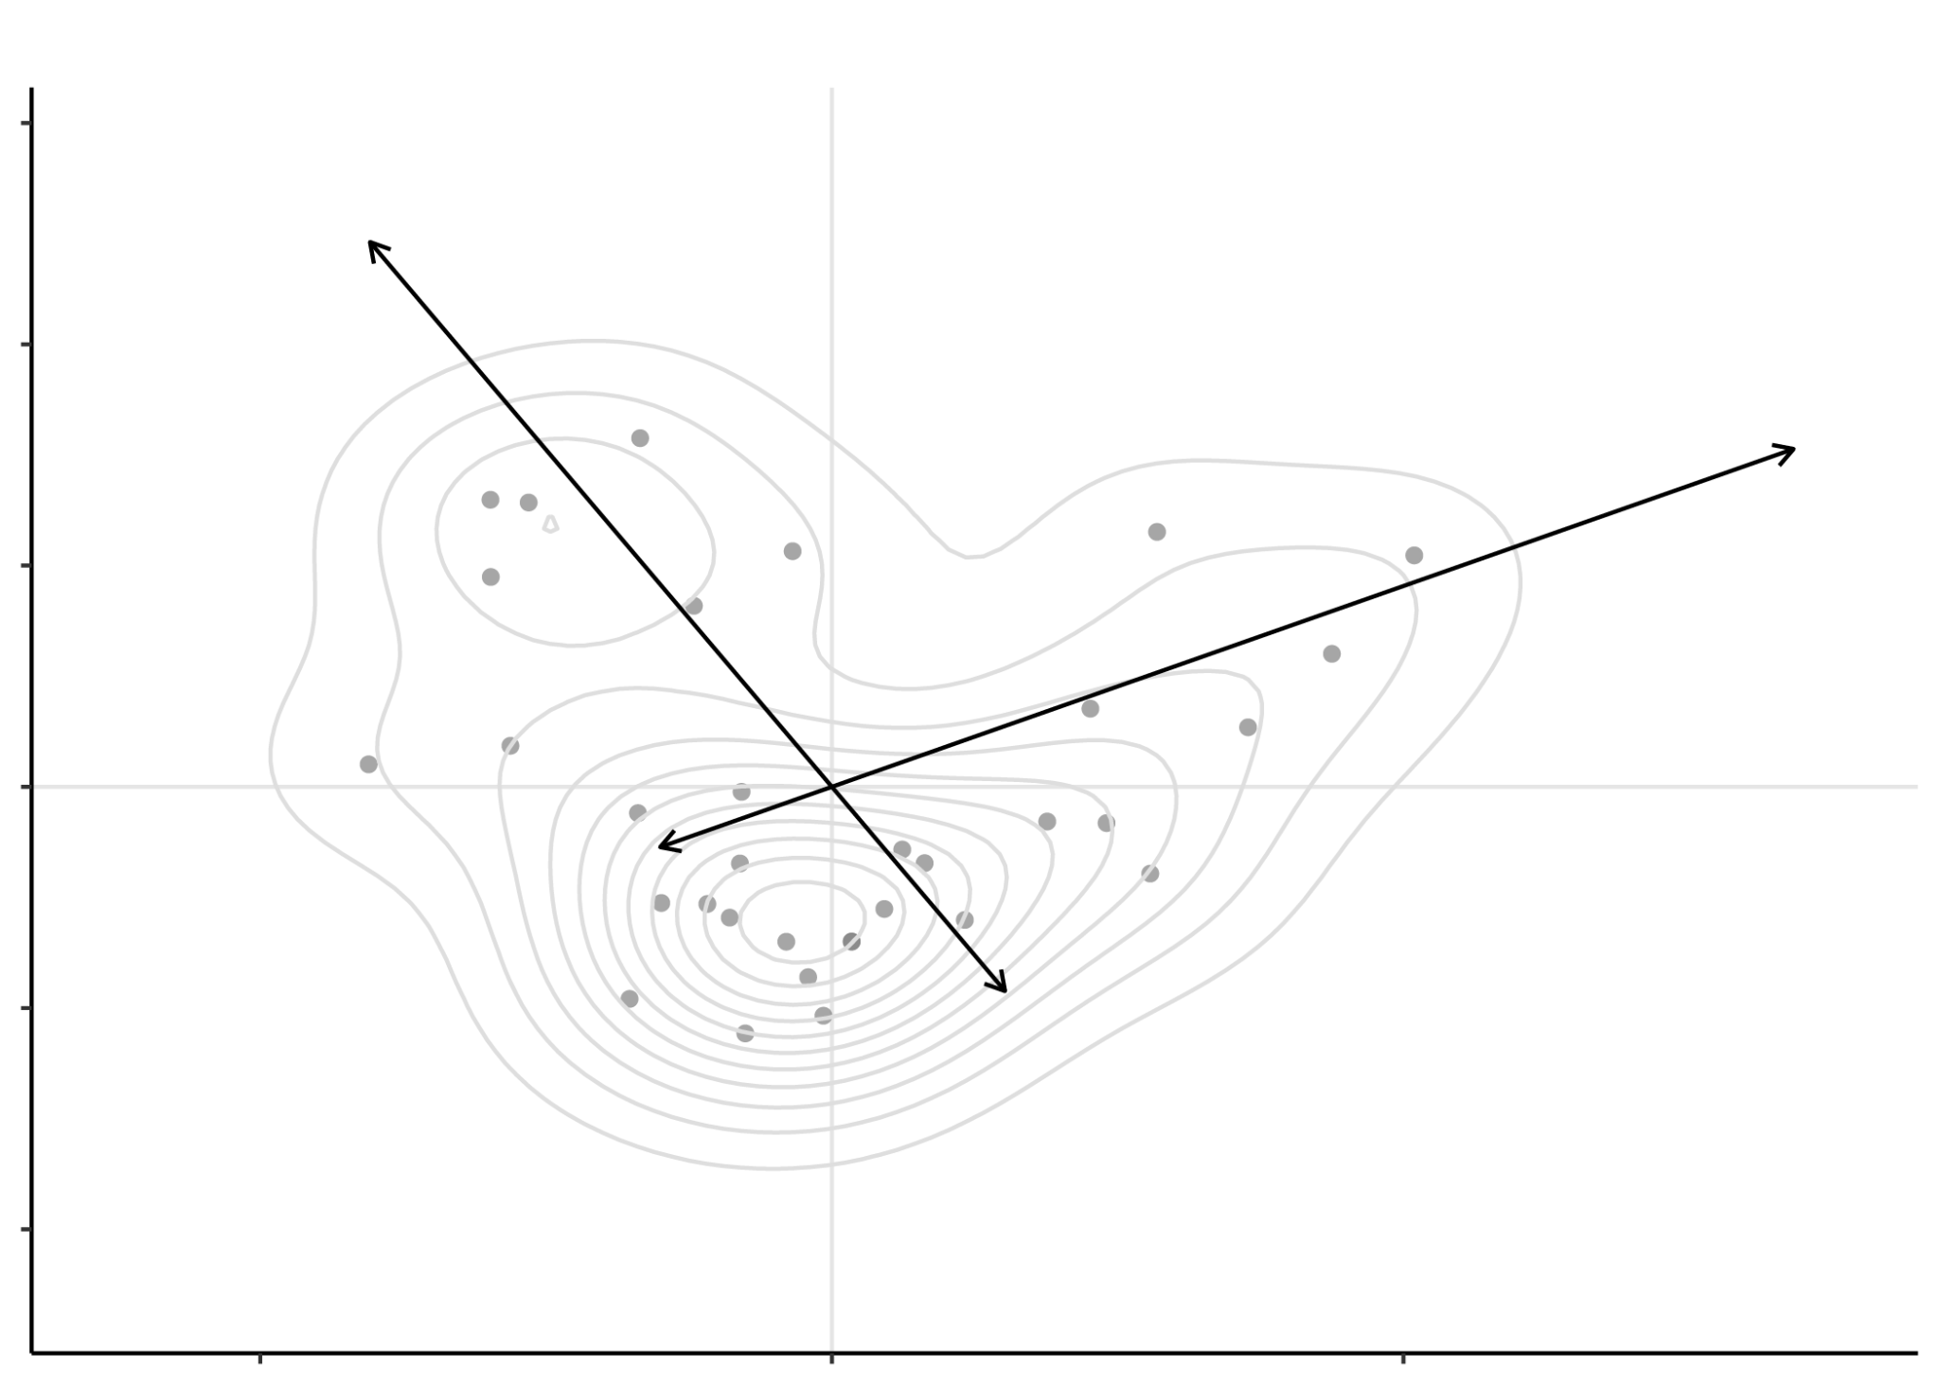
Functional trait fingerprints
Topographic lines form a ‘fingerprint’: volume of the space can be measured with hypervolumes
Notes:
this concept assumes that a system can be characterised by a set of independent axes, e.g. functional traits, resource requirements, or abiotic tolerances. These axes constitute an n-dimensional Euclidean space. A geometrical shape can then be delineated within this space and used to describe the size, position and geometry of the system.

Slide 17
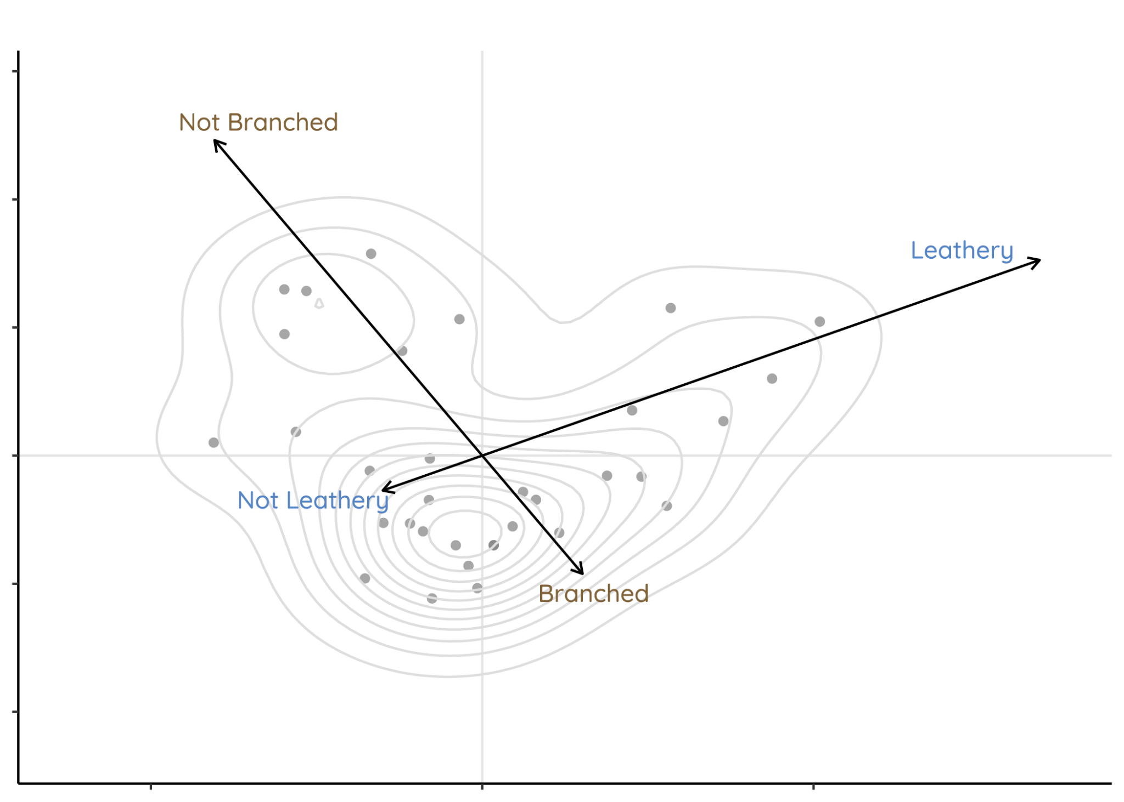
Functional trait fingerprints
‘Leathery’ and ‘branched’ most strongly define this fingerprint, with large volume of not-leathery, branched algae taxa
Notes:
this concept assumes that a system can be characterised by a set of independent axes, e.g. functional traits, resource requirements, or abiotic tolerances. These axes constitute an n-dimensional Euclidean space. A geometrical shape can then be delineated within this space and used to describe the size, position and geometry of the system.

Slide 18
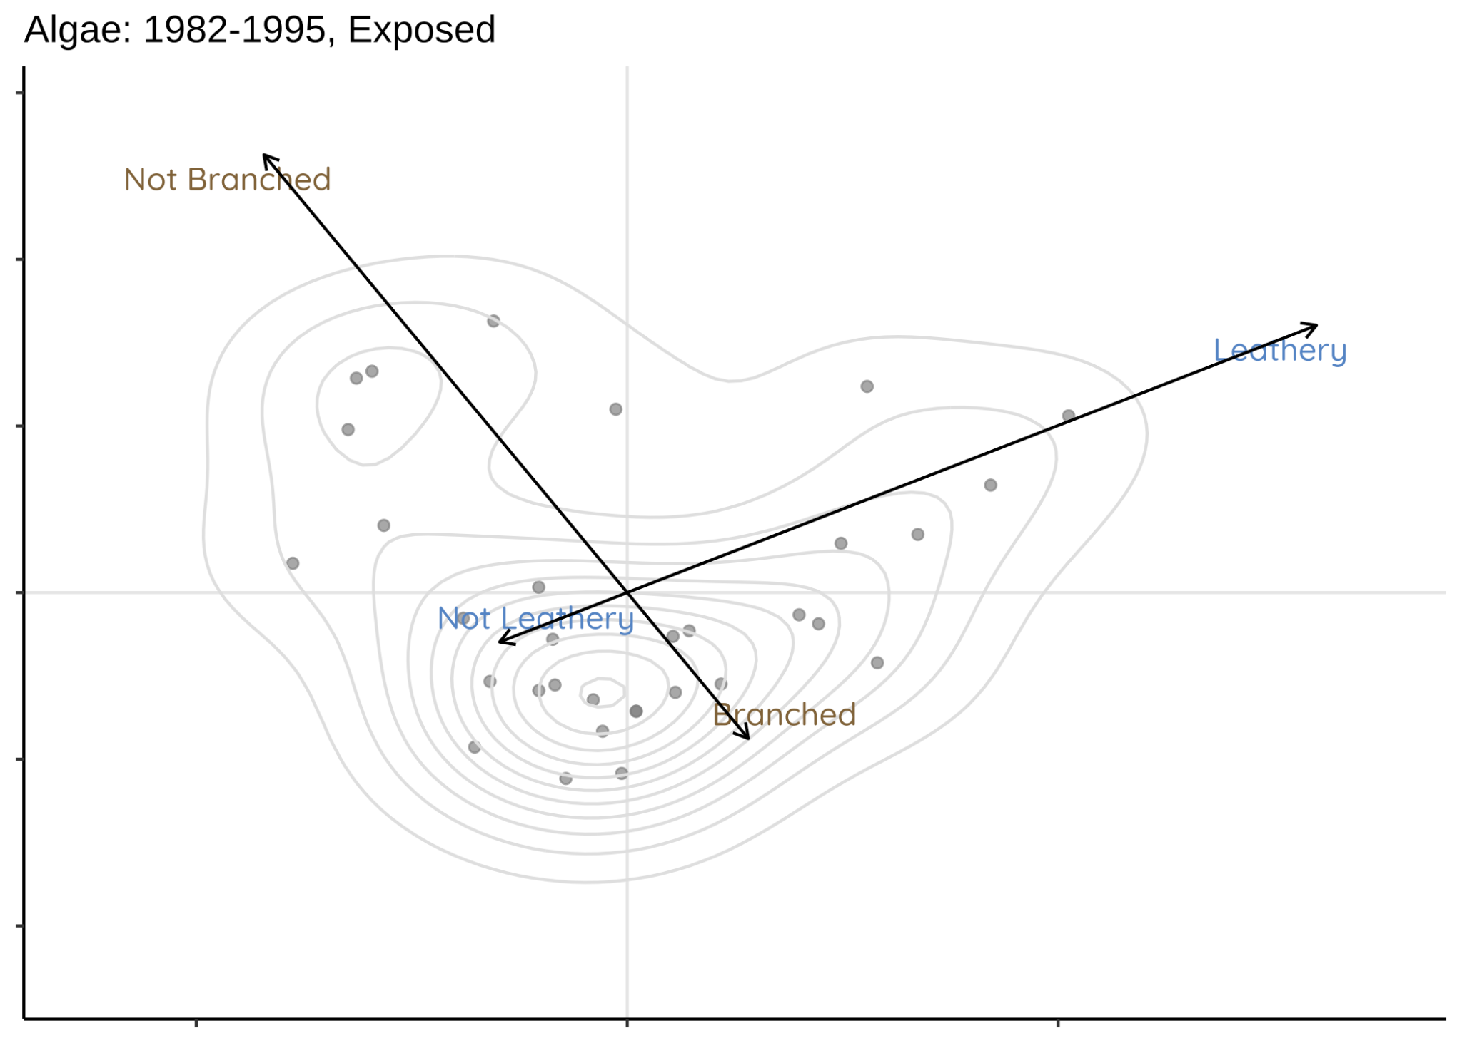
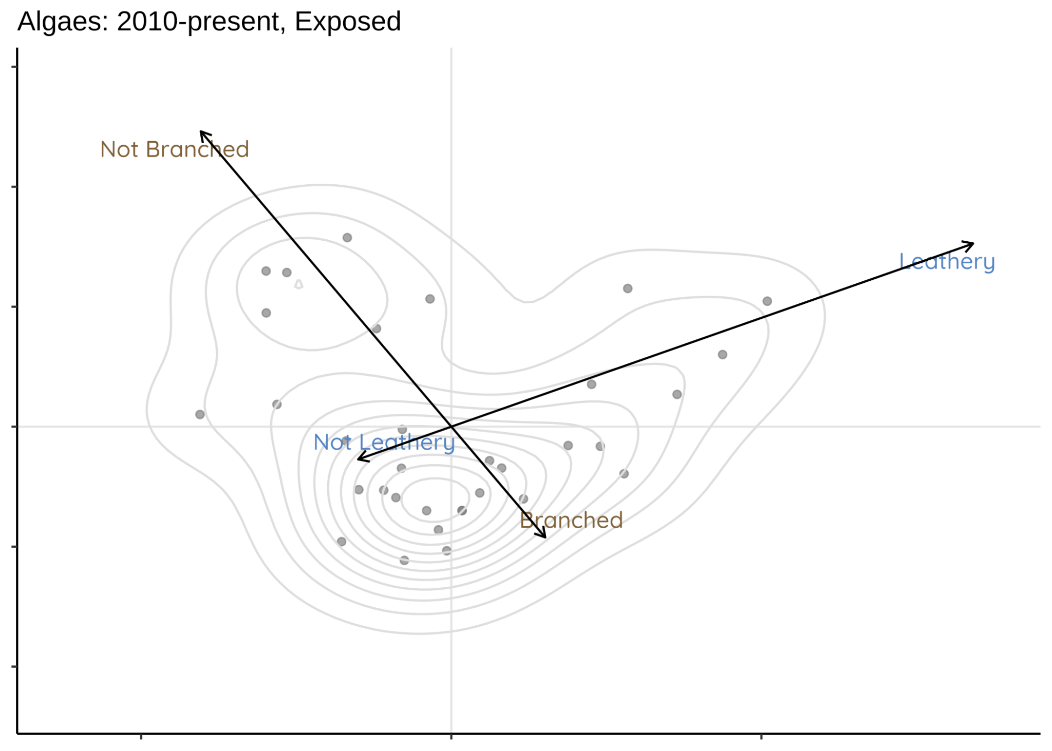
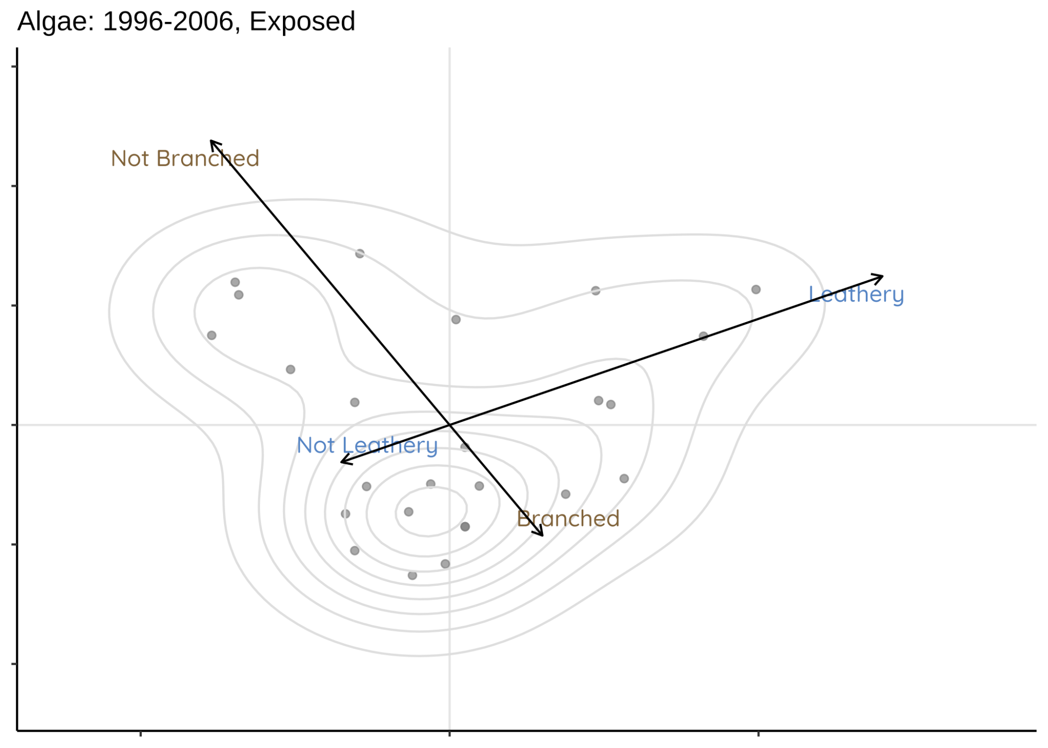
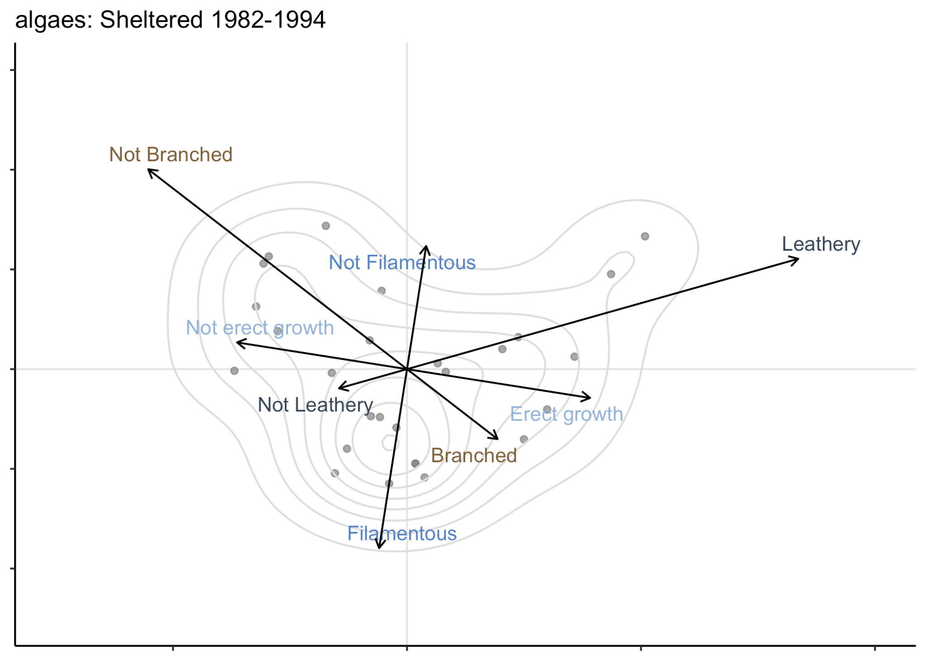
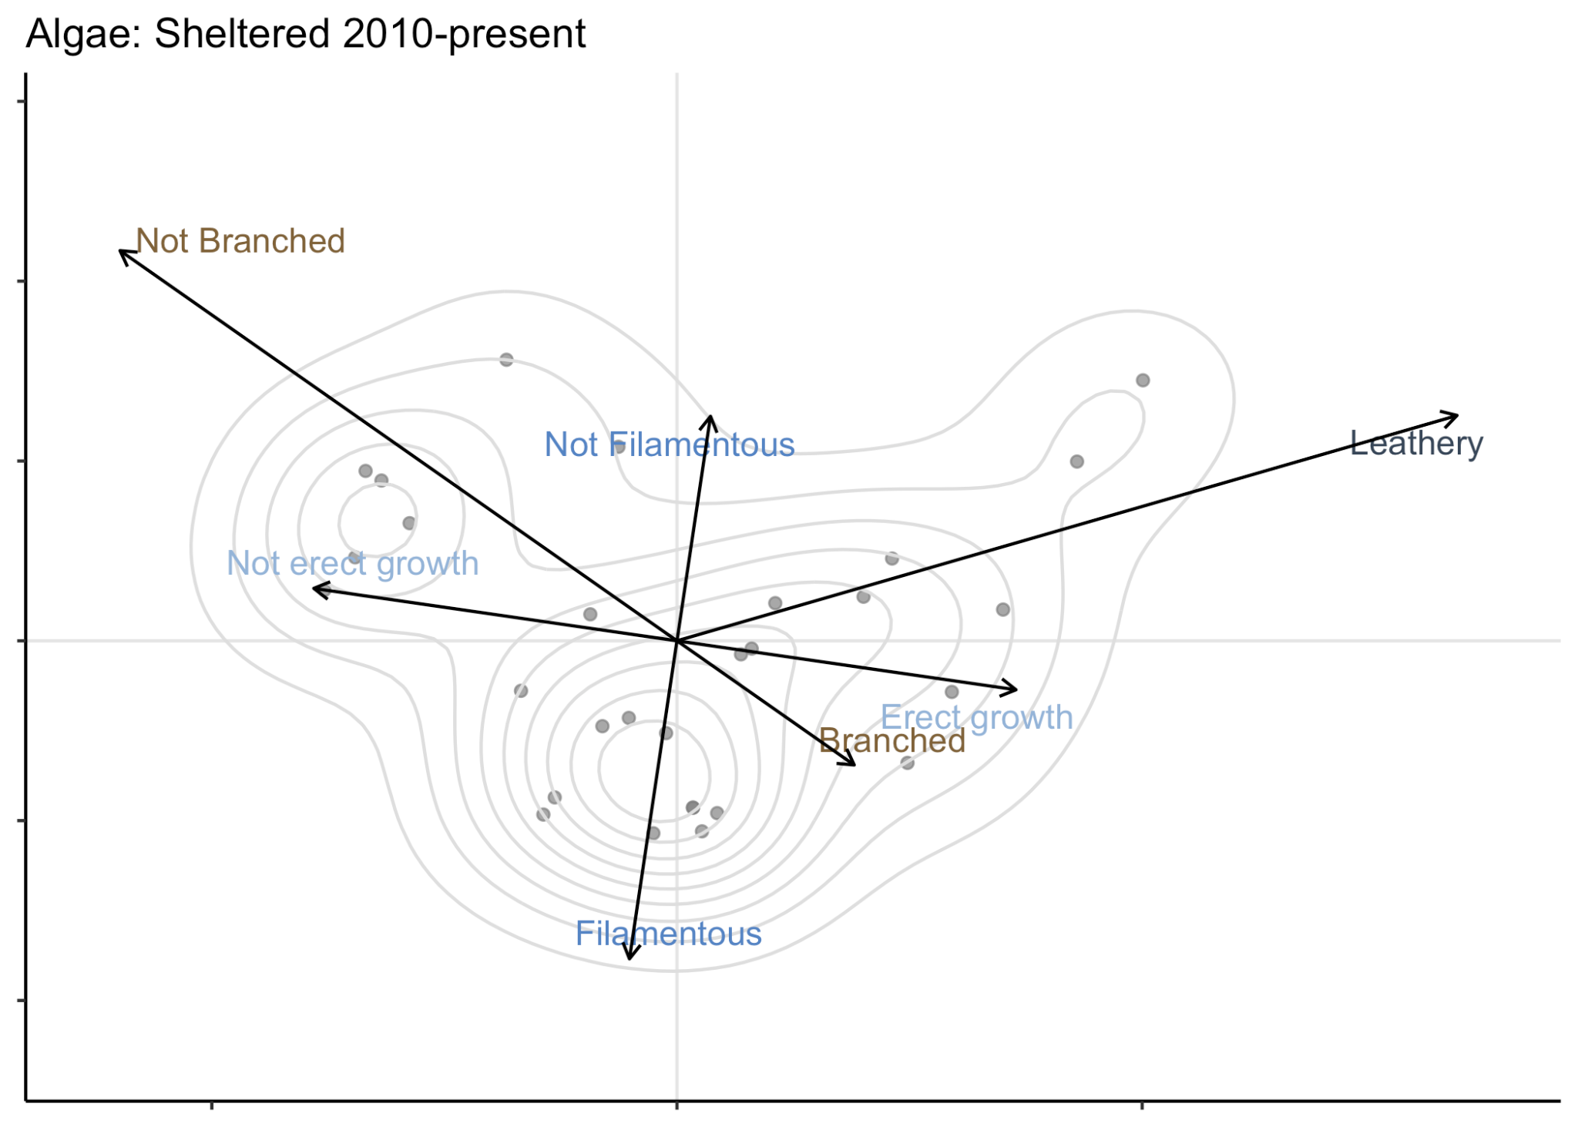
Algae | Exposed: little change
Notes:
this concept assumes that a system can be characterised by a set of independent axes, e.g. functional traits, resource requirements, or abiotic tolerances. These axes constitute an n-dimensional Euclidean space. A geometrical shape can then be delineated within this space and used to describe the size, position and geometry of the system.

Slide 19
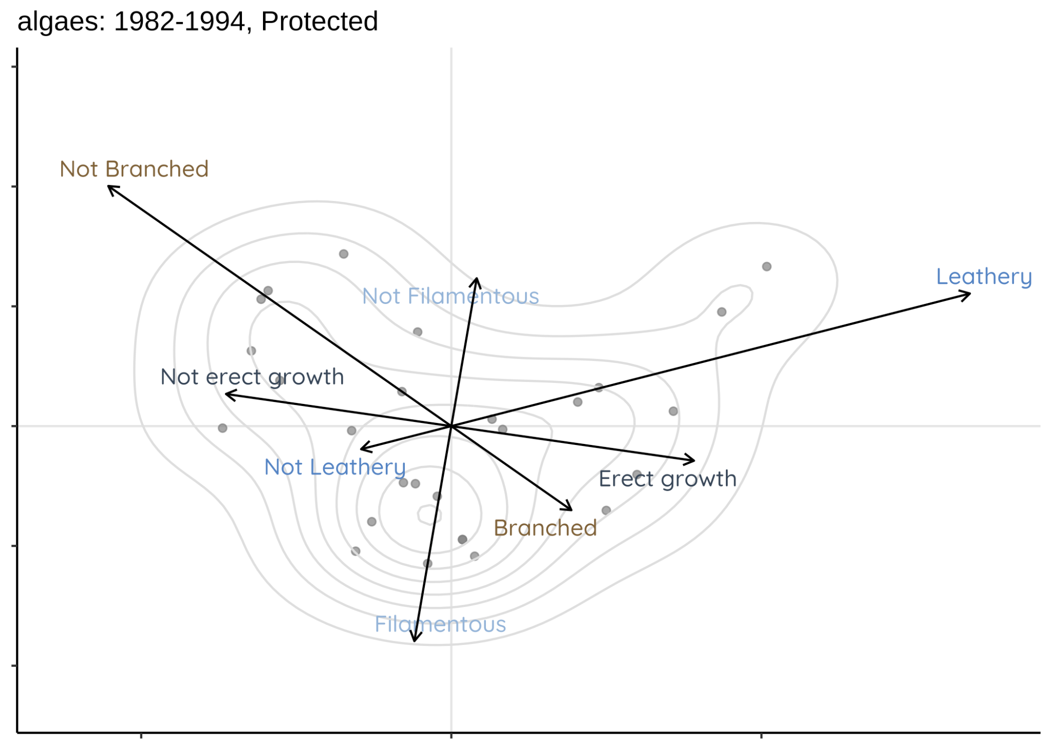
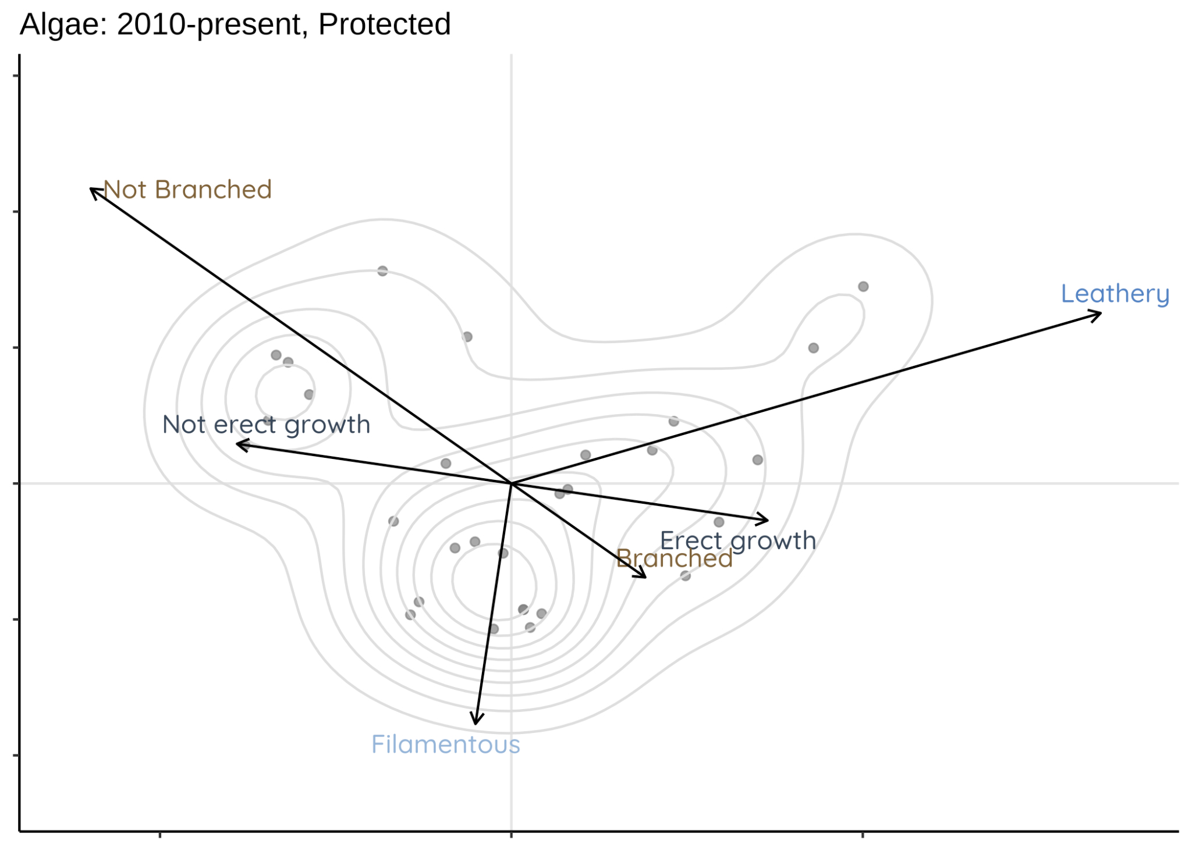
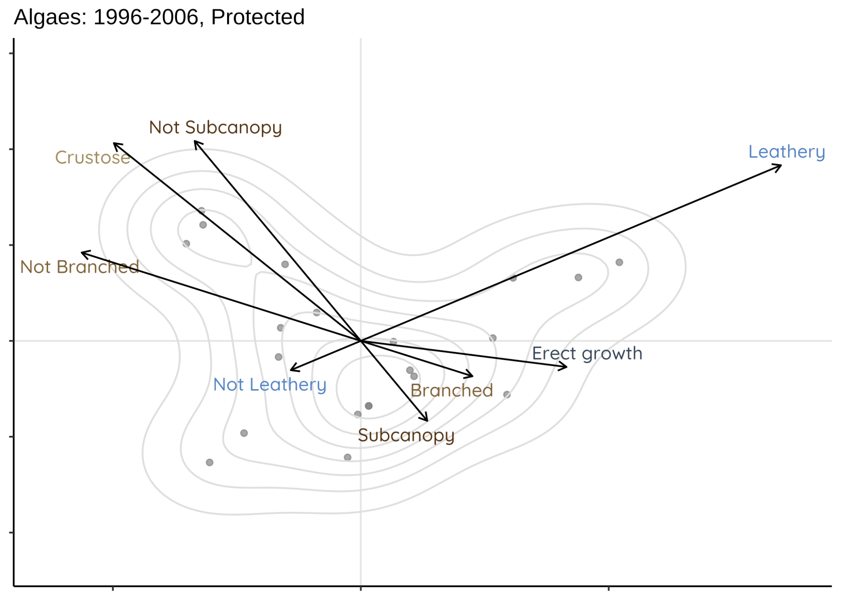
Algae | Protected: more turf + filamentous
More species defining crustose/turf & filamentous trait space
Notes:
this concept assumes that a system can be characterised by a set of independent axes, e.g. functional traits, resource requirements, or abiotic tolerances. These axes constitute an n-dimensional Euclidean space. A geometrical shape can then be delineated within this space and used to describe the size, position and geometry of the system.

Slide 20
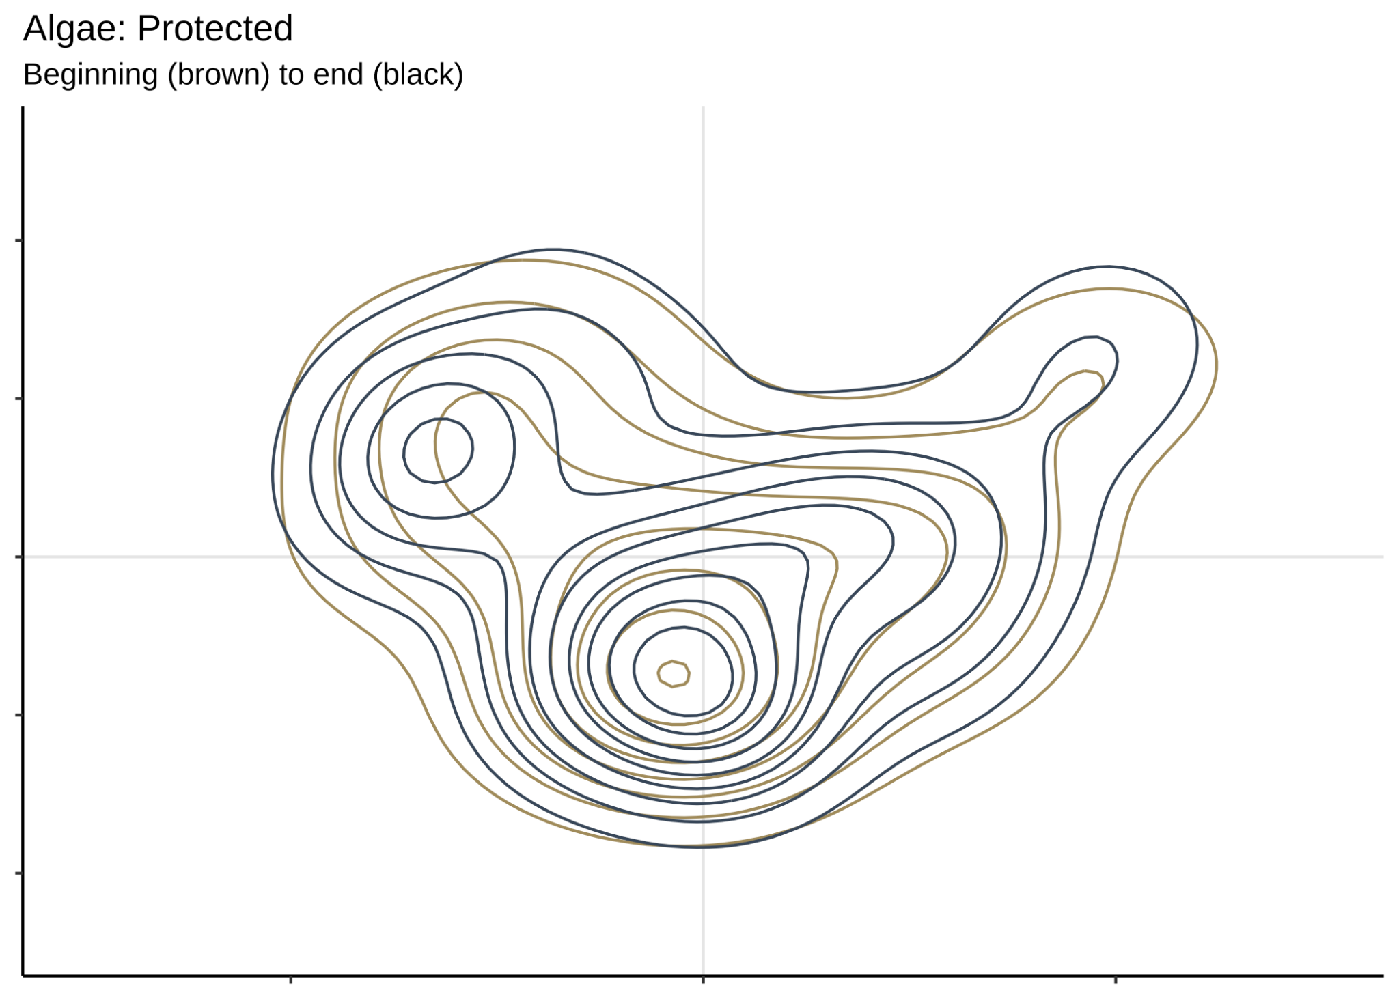
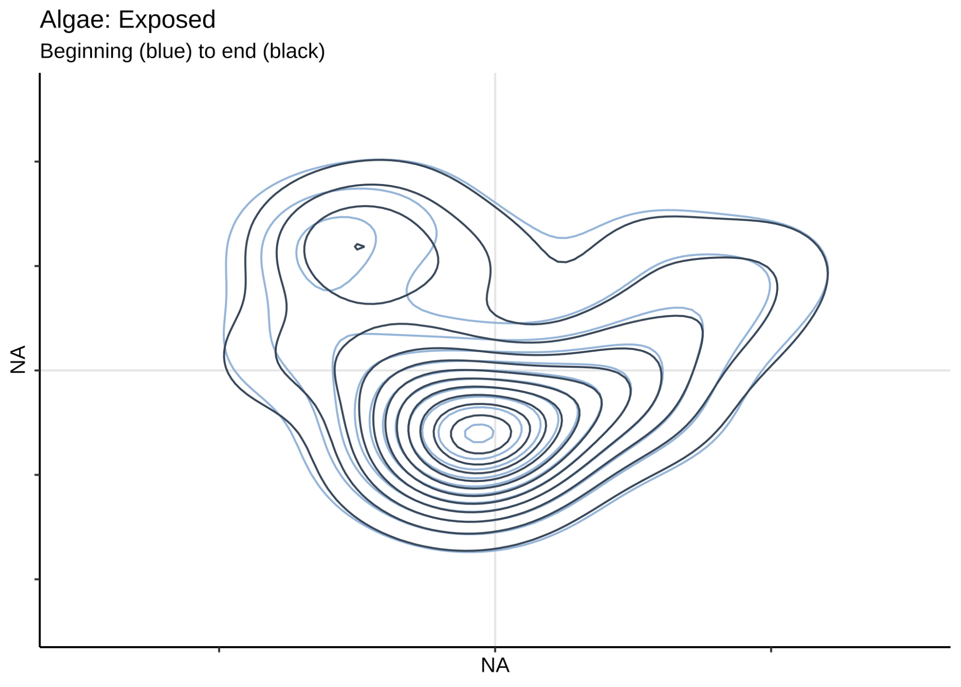
Shape & volume: 1982-94 vs 2010-now
Protected
Exposed
Change was more pronounced in protected; hypervolume calculation 30% trait space exclusively 1982-1994, 30% exclusively 2010-now
Change was greater on protected side: ~30% change in hypervolume!
Notes:
this concept assumes that a system can be characterised by a set of independent axes, e.g. functional traits, resource requirements, or abiotic tolerances. These axes constitute an n-dimensional Euclidean space. A geometrical shape can then be delineated within this space and used to describe the size, position and geometry of the system.

Slide 21
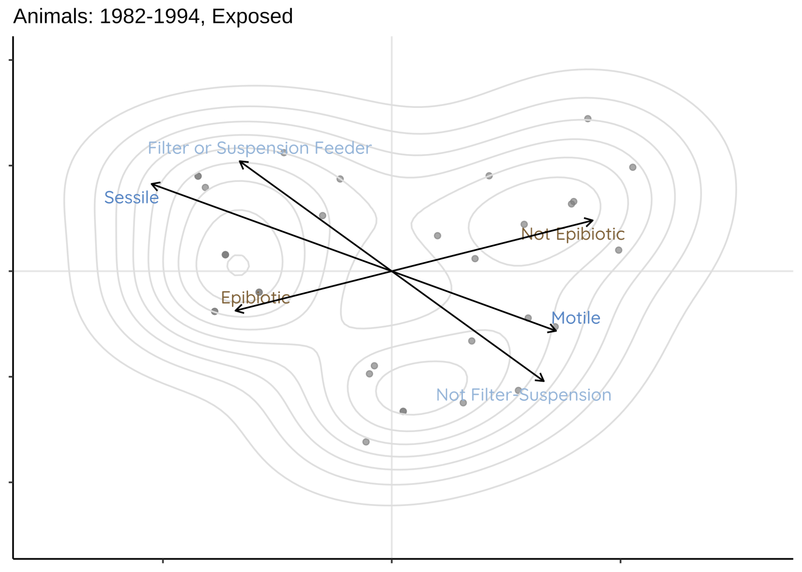
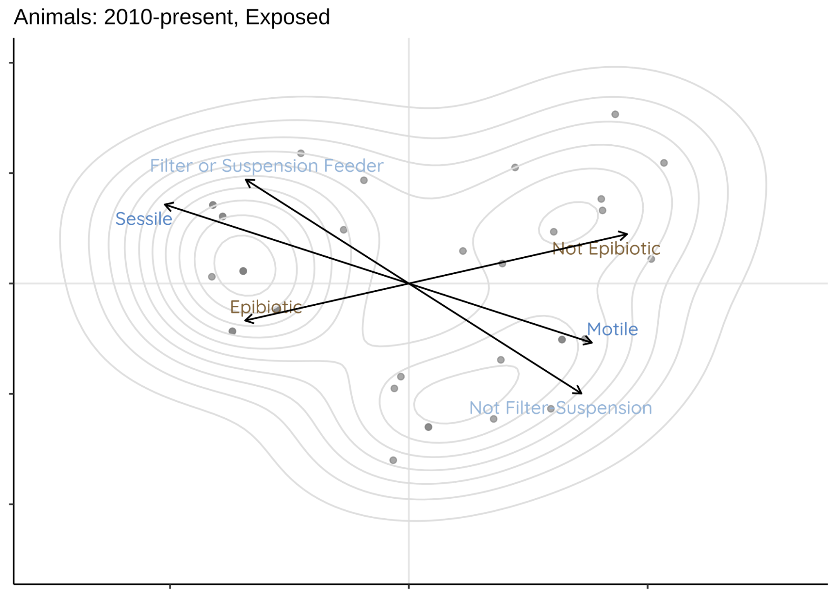
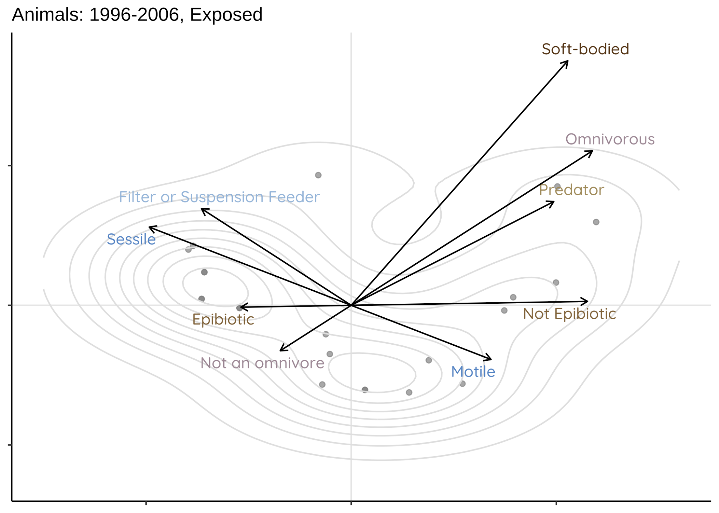
Animals | Exposed: little change (wormy interlude)
Lots of different worms found here
Notes:
this concept assumes that a system can be characterised by a set of independent axes, e.g. functional traits, resource requirements, or abiotic tolerances. These axes constitute an n-dimensional Euclidean space. A geometrical shape can then be delineated within this space and used to describe the size, position and geometry of the system.

Slide 22
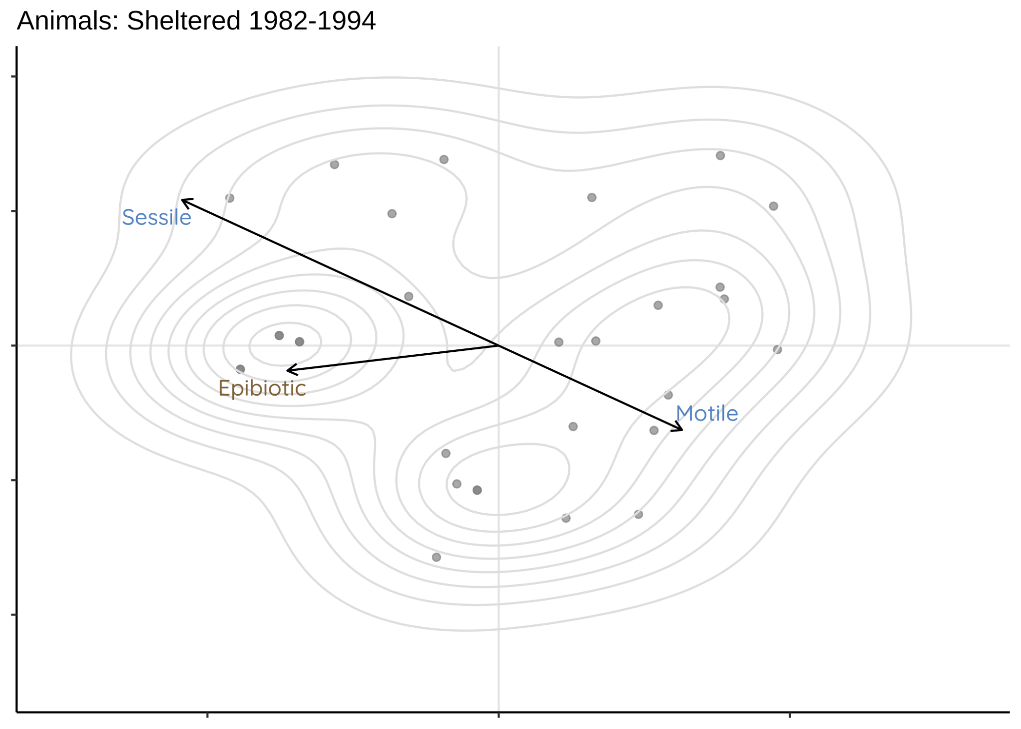
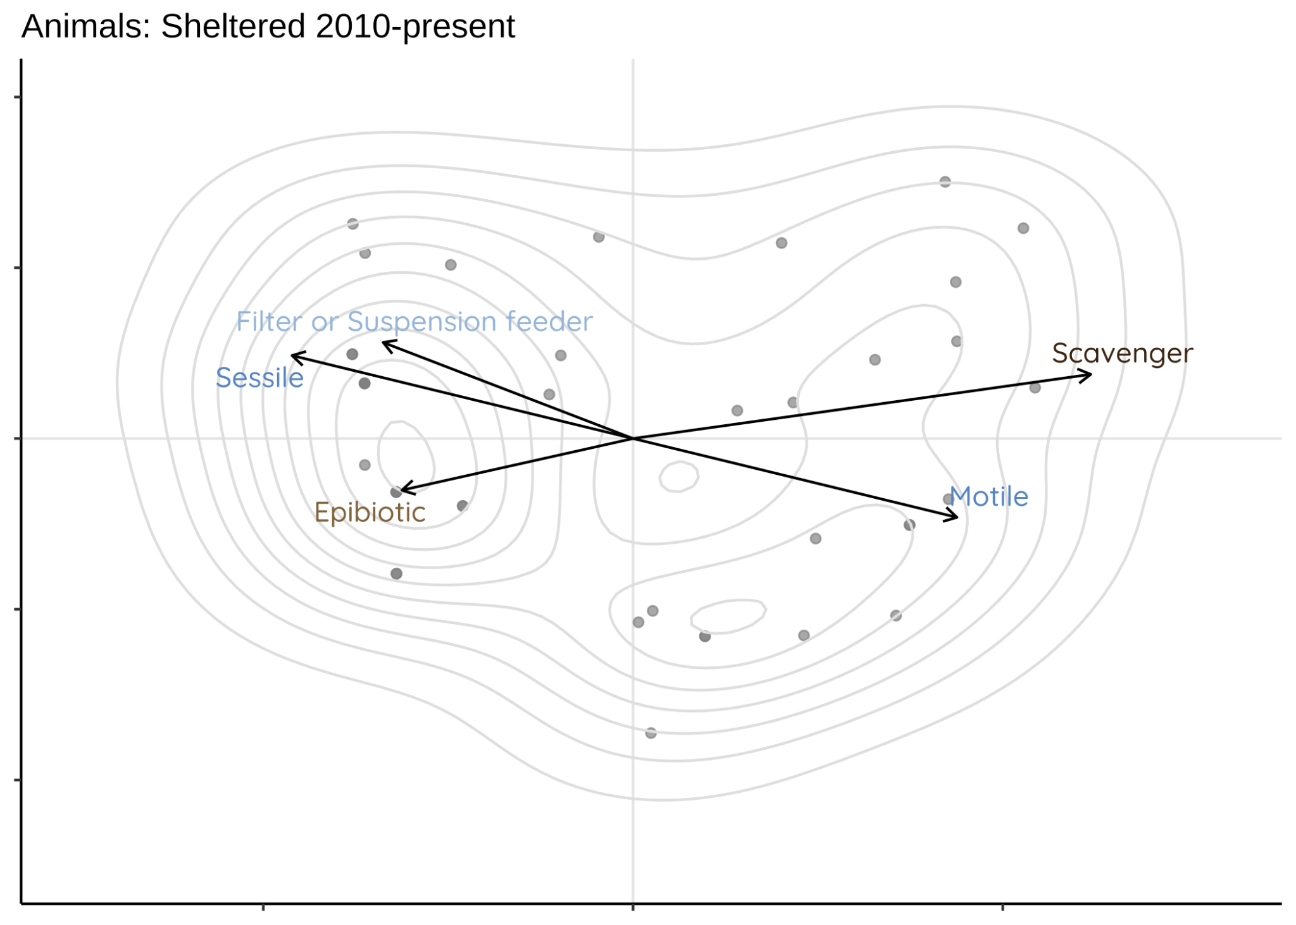
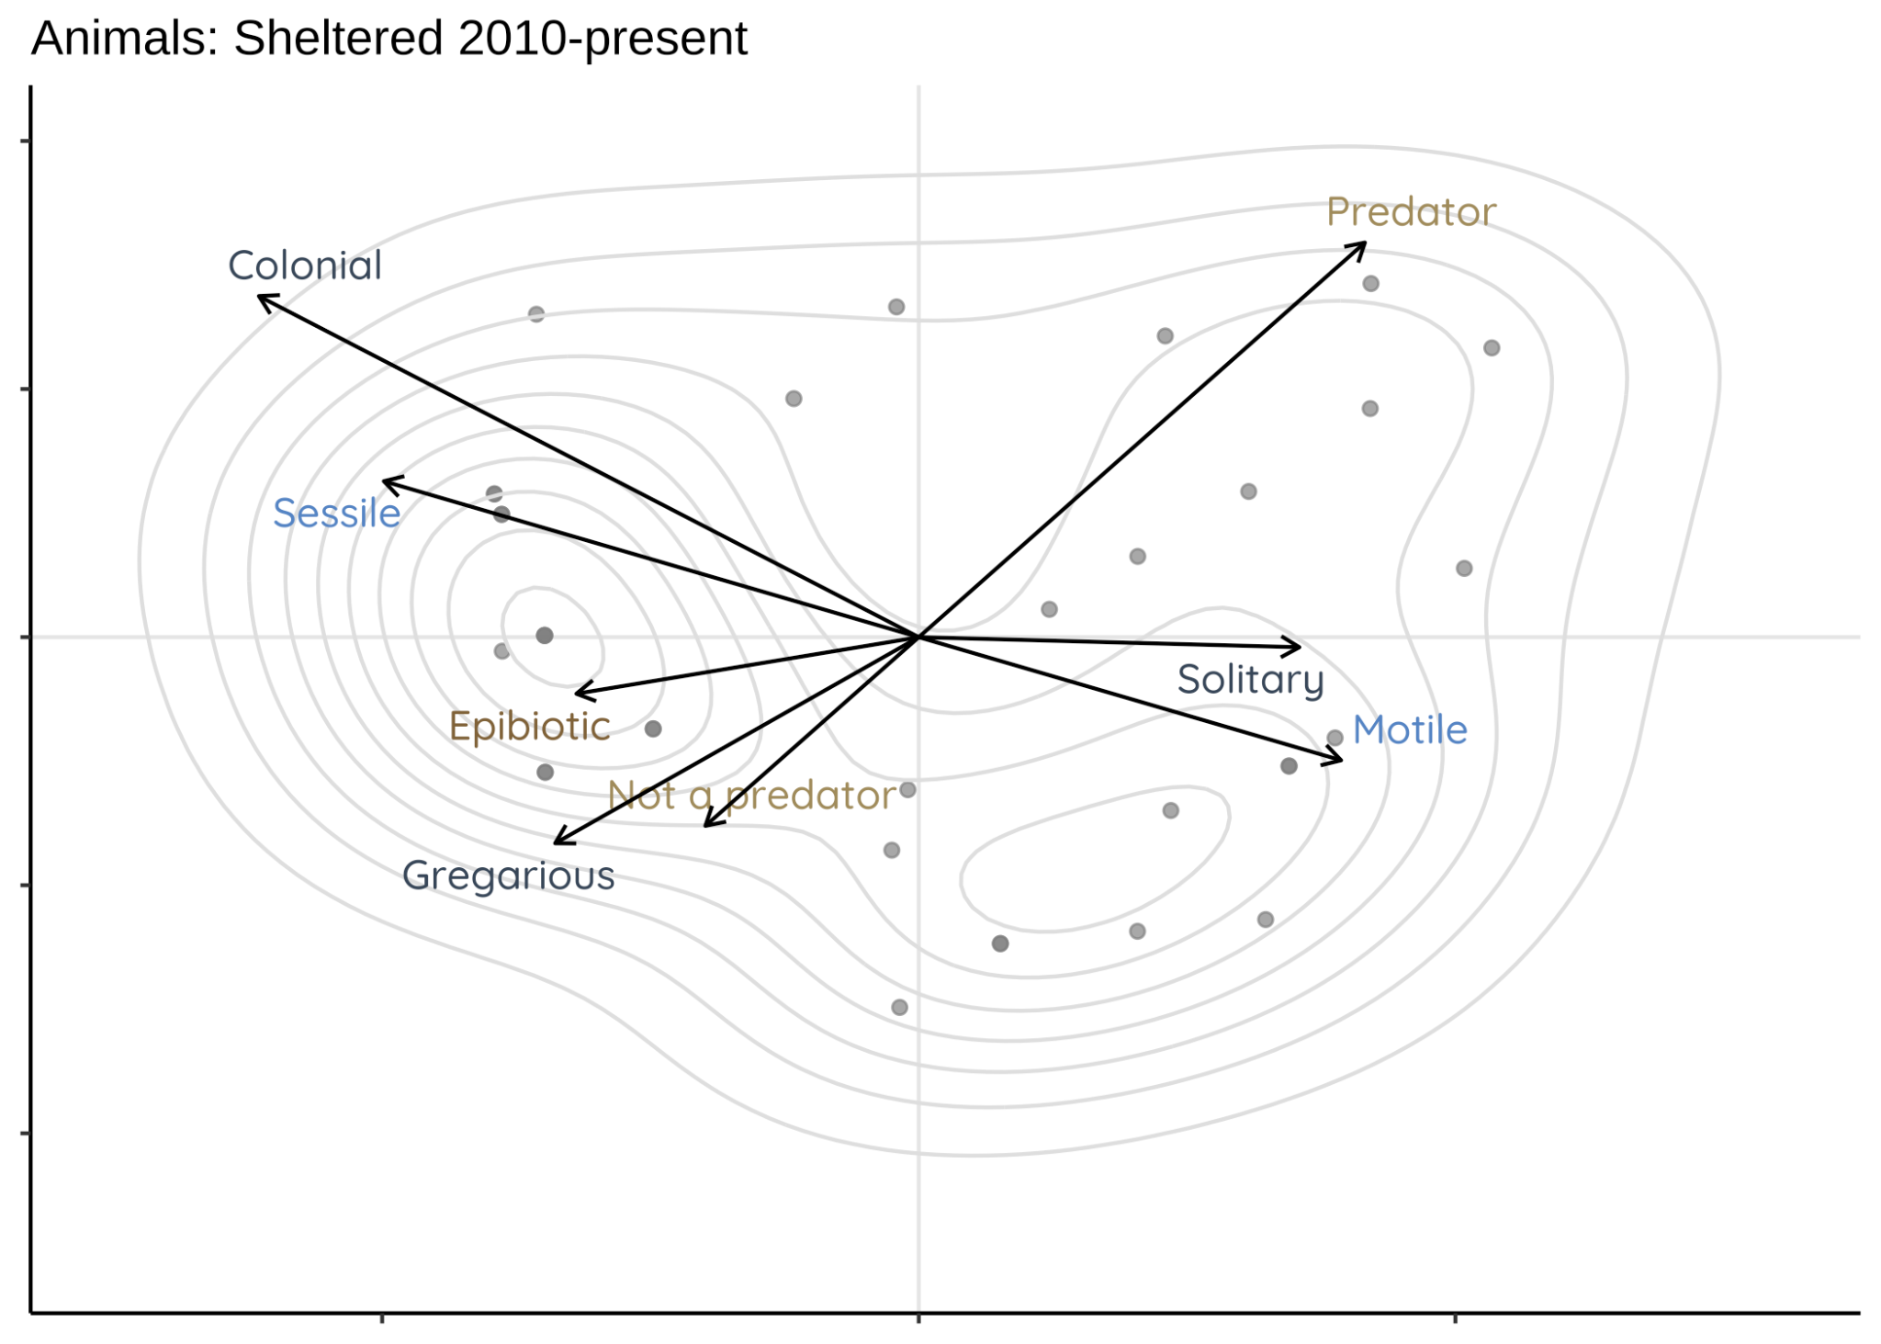
Animals | Protected: Mesopredator release!
Increased impact from solitary predators / scavengers
Changes in functional space over time, were more evident in the sheltered site of the island.
Notes:
Middle: asterias rubens (large sea star), cancer crab -- atlantic rock crab, worms (eg free living polychaetes, turbellarians), asian crab, dog whelk
this concept assumes that a system can be characterised by a set of independent axes, e.g. functional traits, resource requirements, or abiotic tolerances. These axes constitute an n-dimensional Euclidean space. A geometrical shape can then be delineated within this space and used to describe the size, position and geometry of the system.

Slide 23
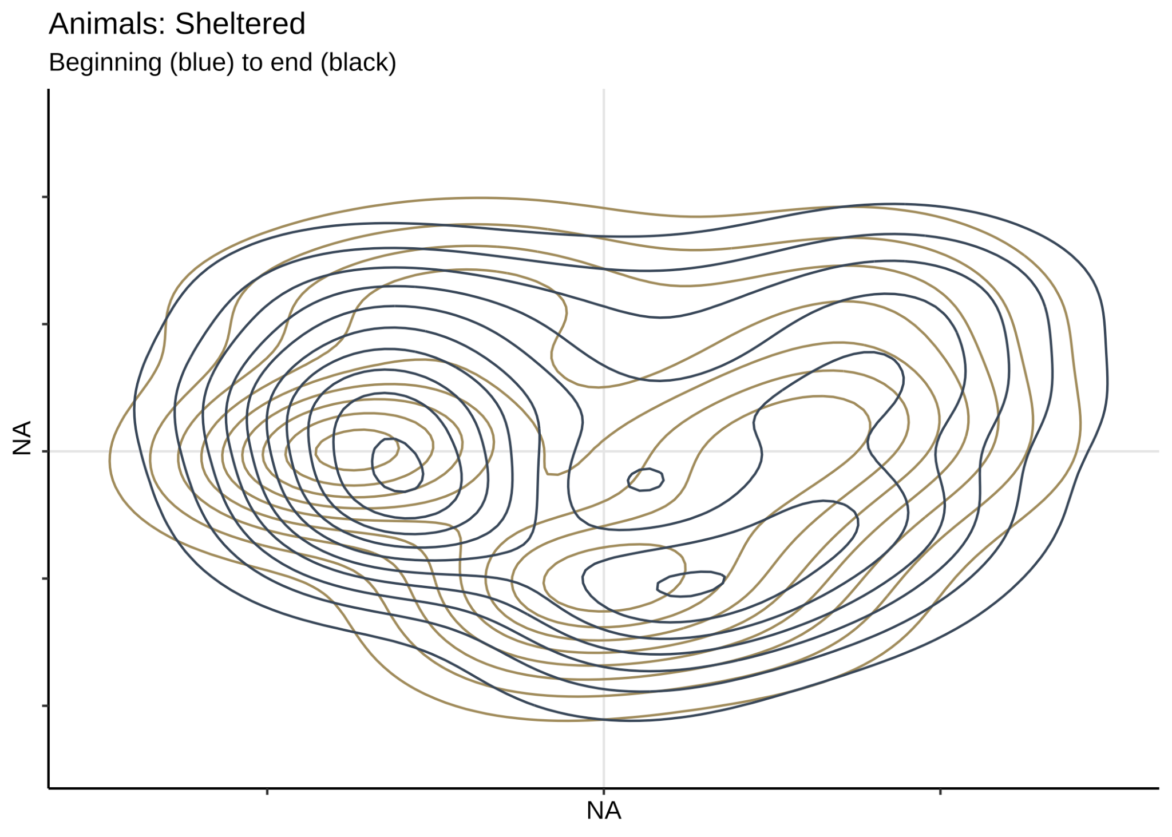
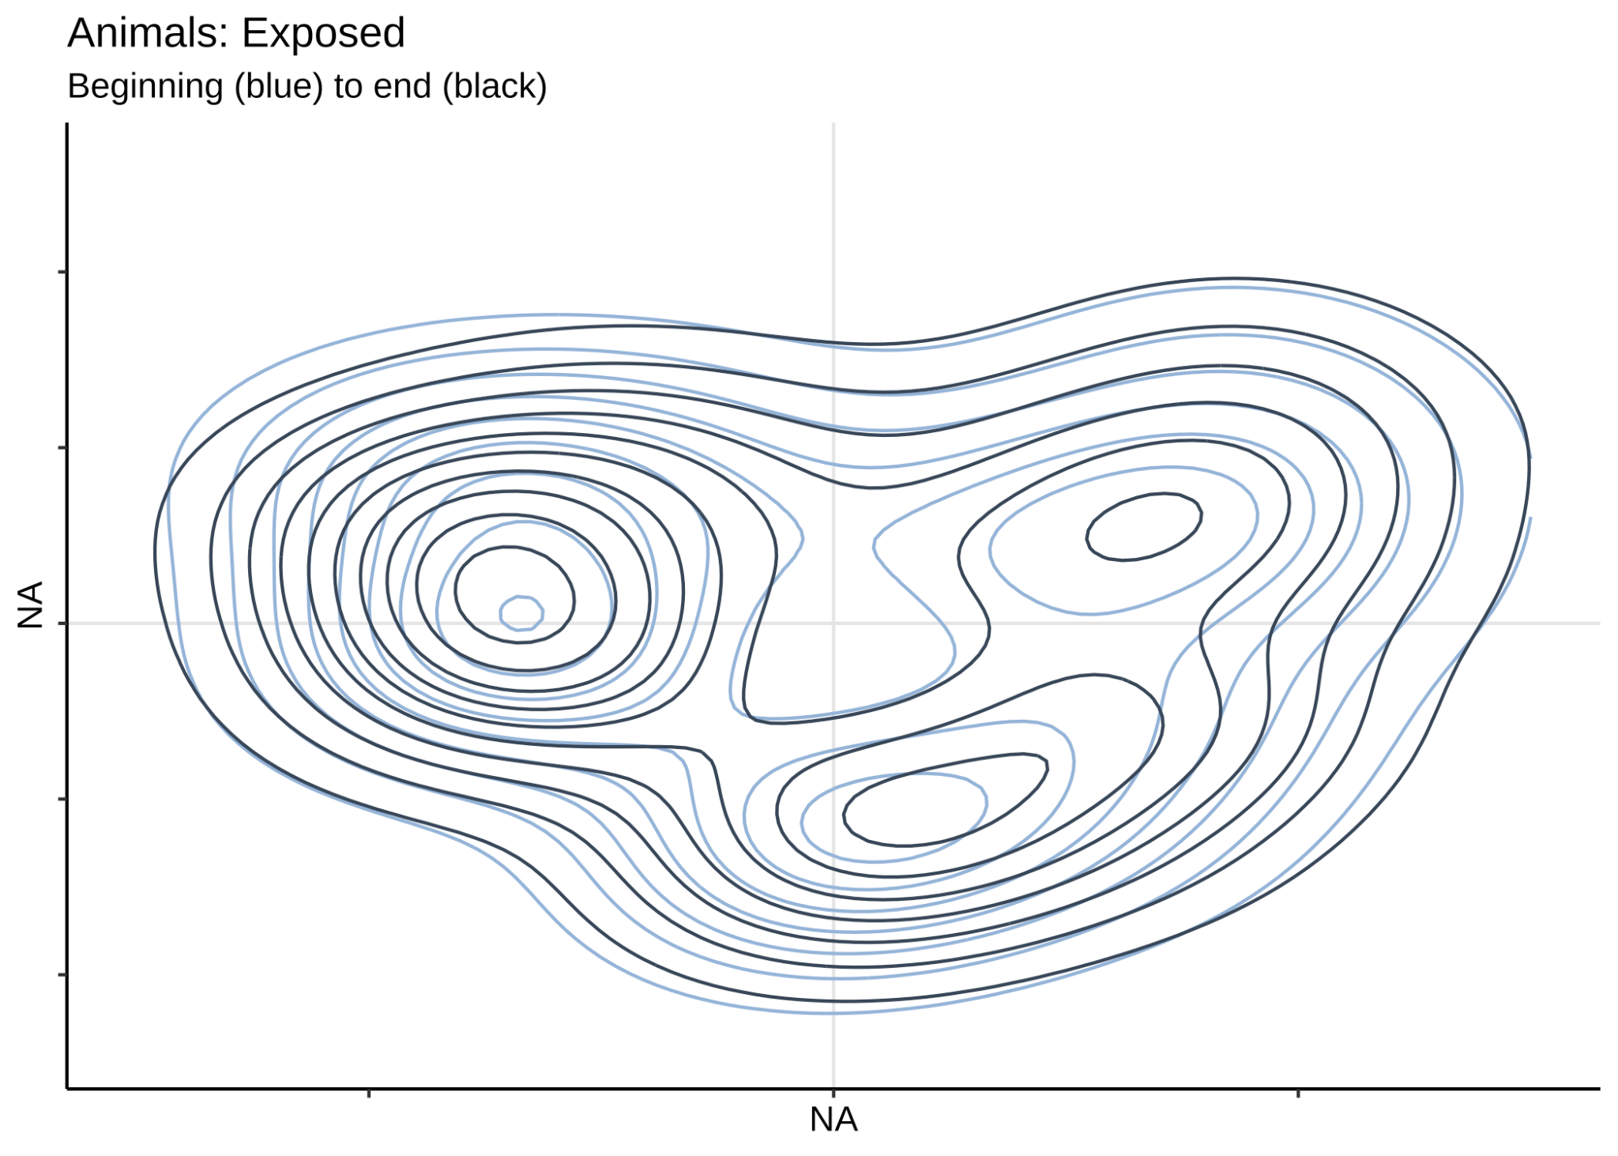
Shape & volume: 1982-94 vs 2010-now
Protected
Exposed
… and change in trait space was still more pronounced on the protected side
Functional space changed over time, due to species extirpations and to novel additions to the marine assemblage. 57 % of the functional space volume that was occupied in “ 1982-1994 was unoccupied in 2010-present [extirpations]
46 % of the volume occupied in “2010-present” were unoccupied in “1982-1994” [novel additions ]
Traits related with dispersal and sociality partially explained the changes in the hypervolume overtime.
More change in fingerprint than algae; greater on protected side: ~50% change in hypervolume!
Notes:
Algae end: fucus, ascophyllum, Elachista fucicola (tufted, globose, filamentous) rusty rock,
this concept assumes that a system can be characterised by a set of independent axes, e.g. functional traits, resource requirements, or abiotic tolerances. These axes constitute an n-dimensional Euclidean space. A geometrical shape can then be delineated within this space and used to describe the size, position and geometry of the system.

Slide 24
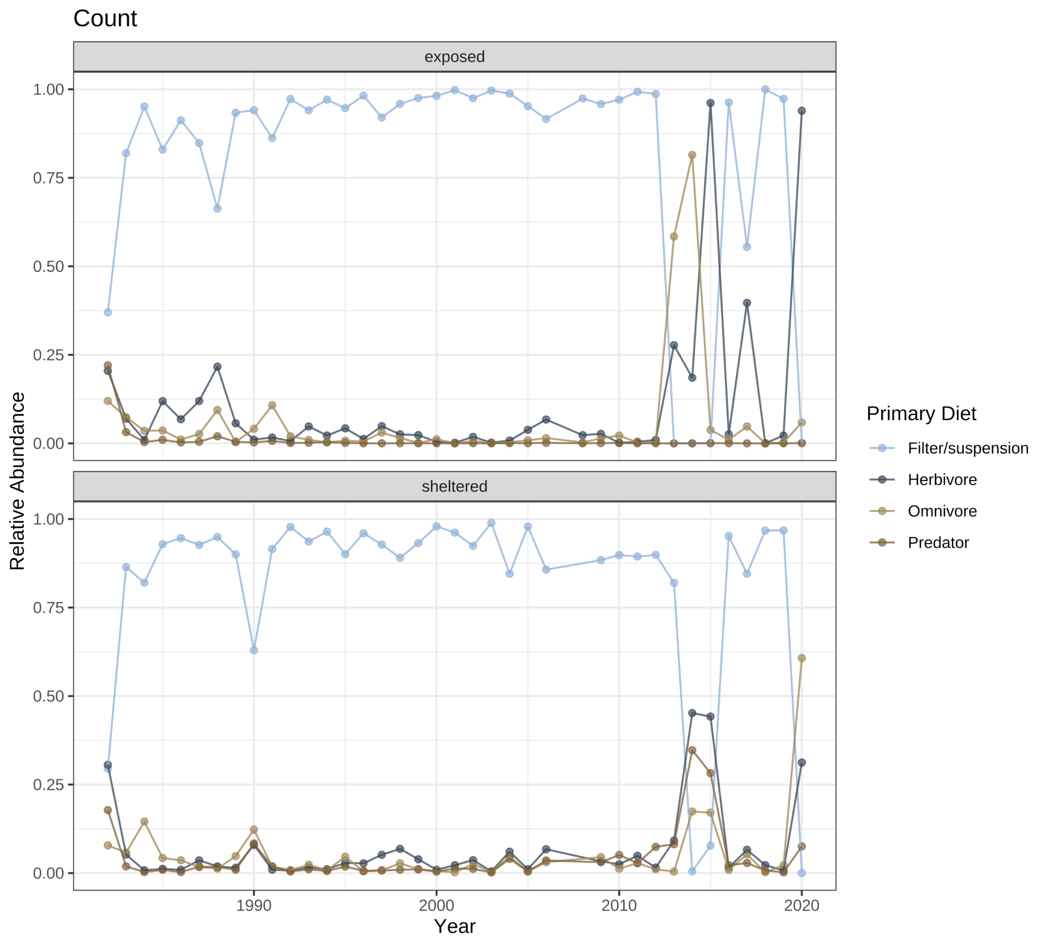
Community-level: increased variation since 2010
Exposed
What do they usually eat?
Filter Feeders
Herbivores
Omnivores
Predators
Protected
Count data: relative abundance
Notes:
Count is of traits; not species

Slide 25
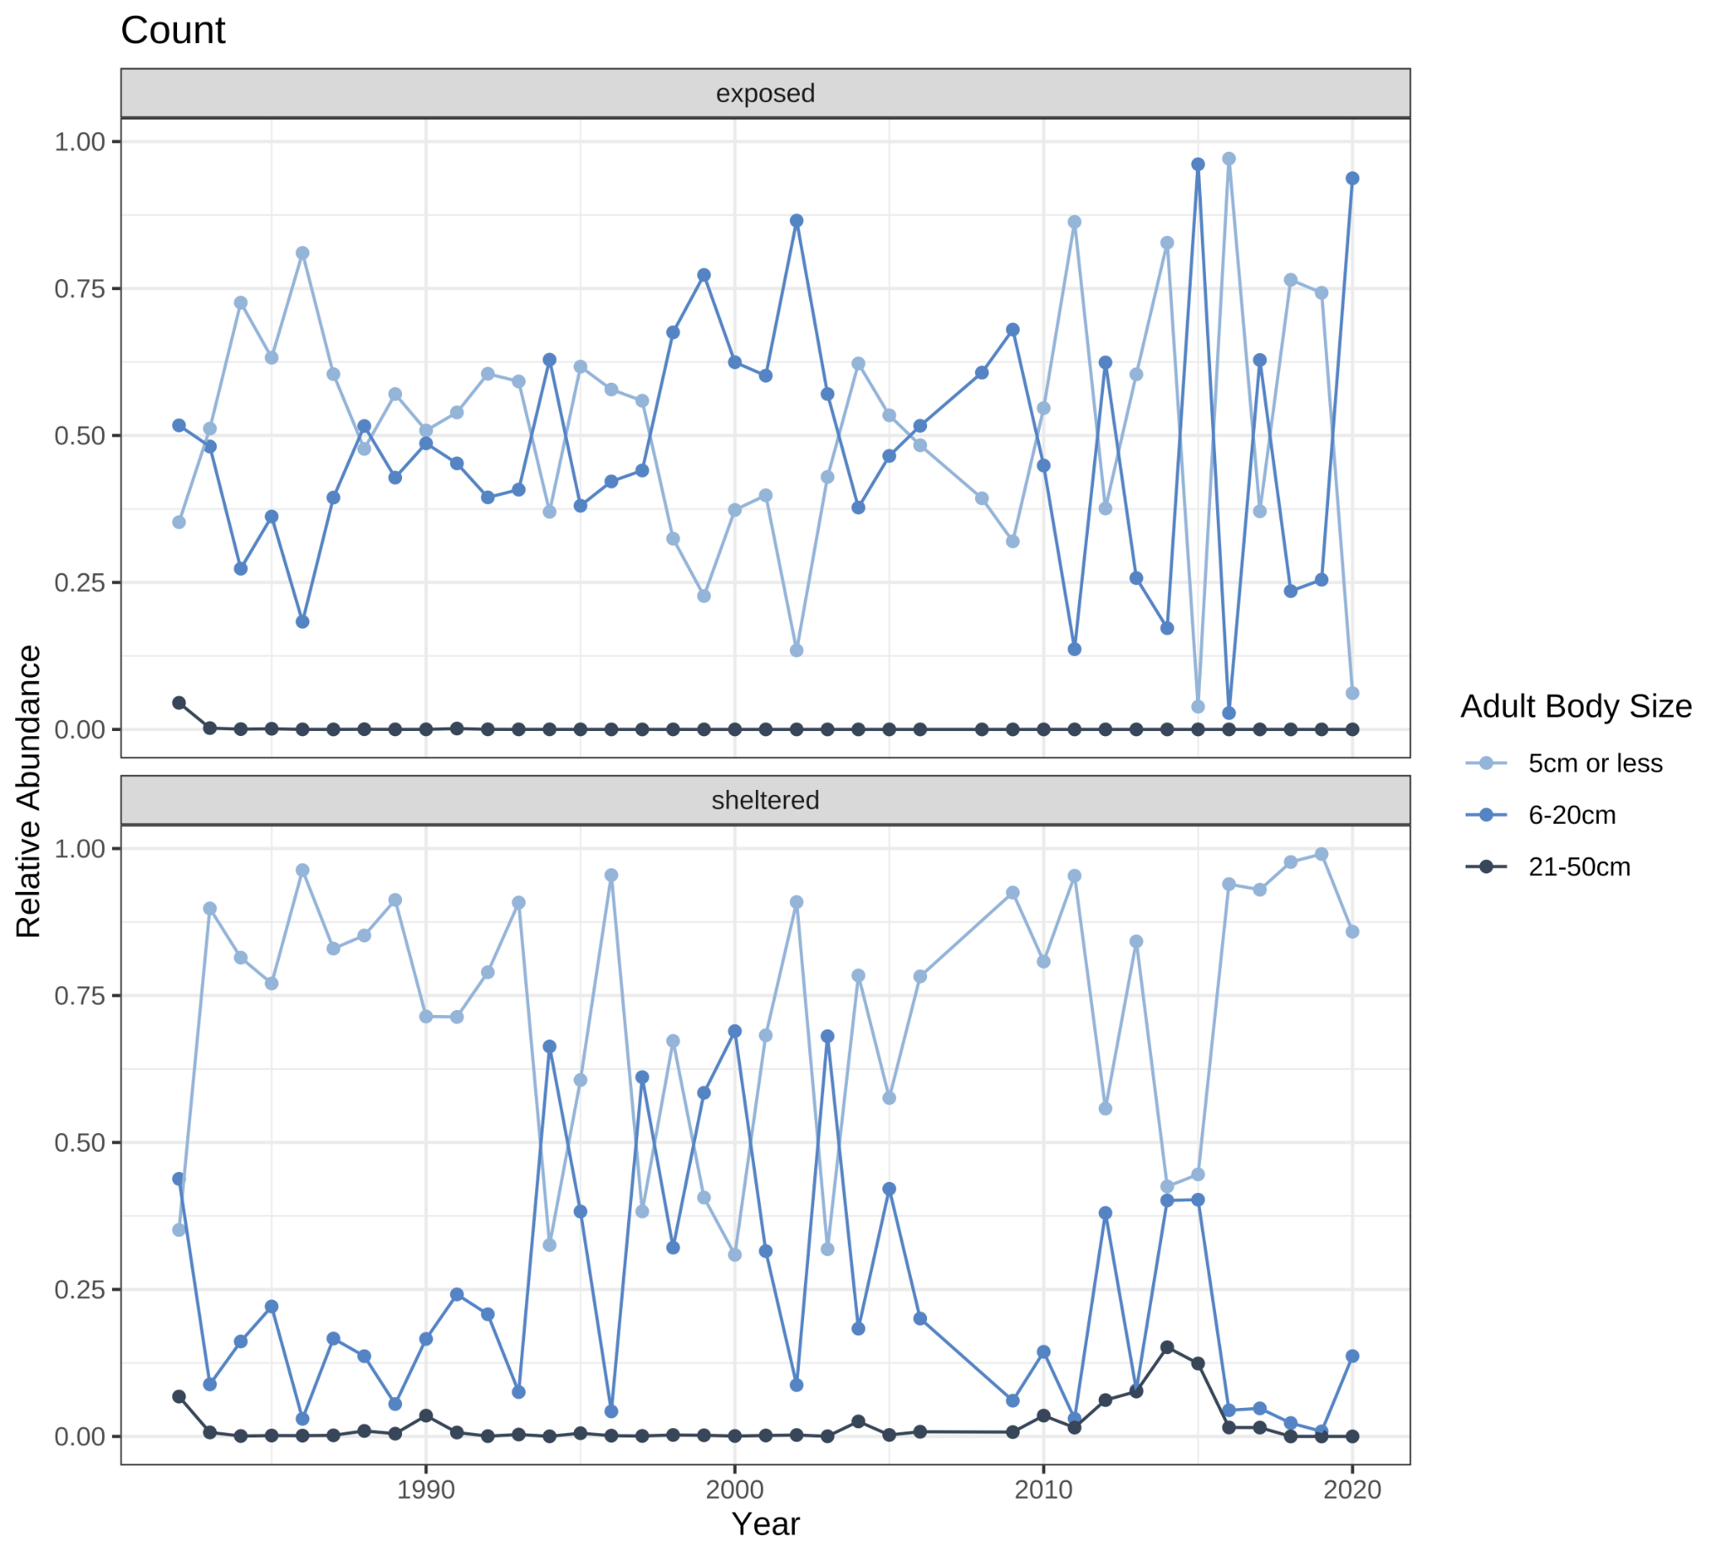
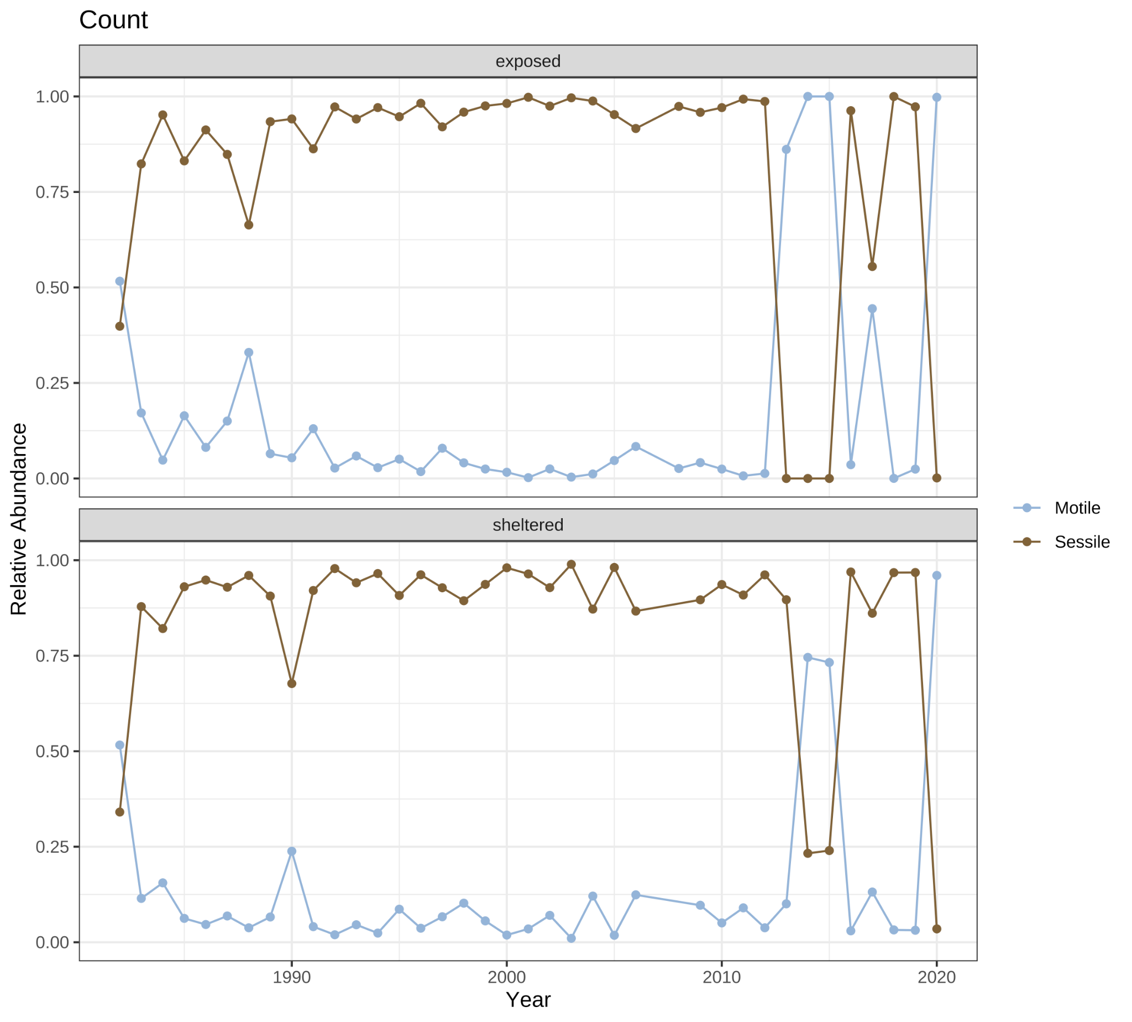
Community-level: increased variation since 2010
Exposed
Exposed
E
E
Are adults mobile or sessile?
Protected
Protected
How big are adults?
> 5cm 5-20cm 21-50cm
Count data: relative abundance
Notes:
Change in relative abundance of functional-trait categories across time

Slide 26
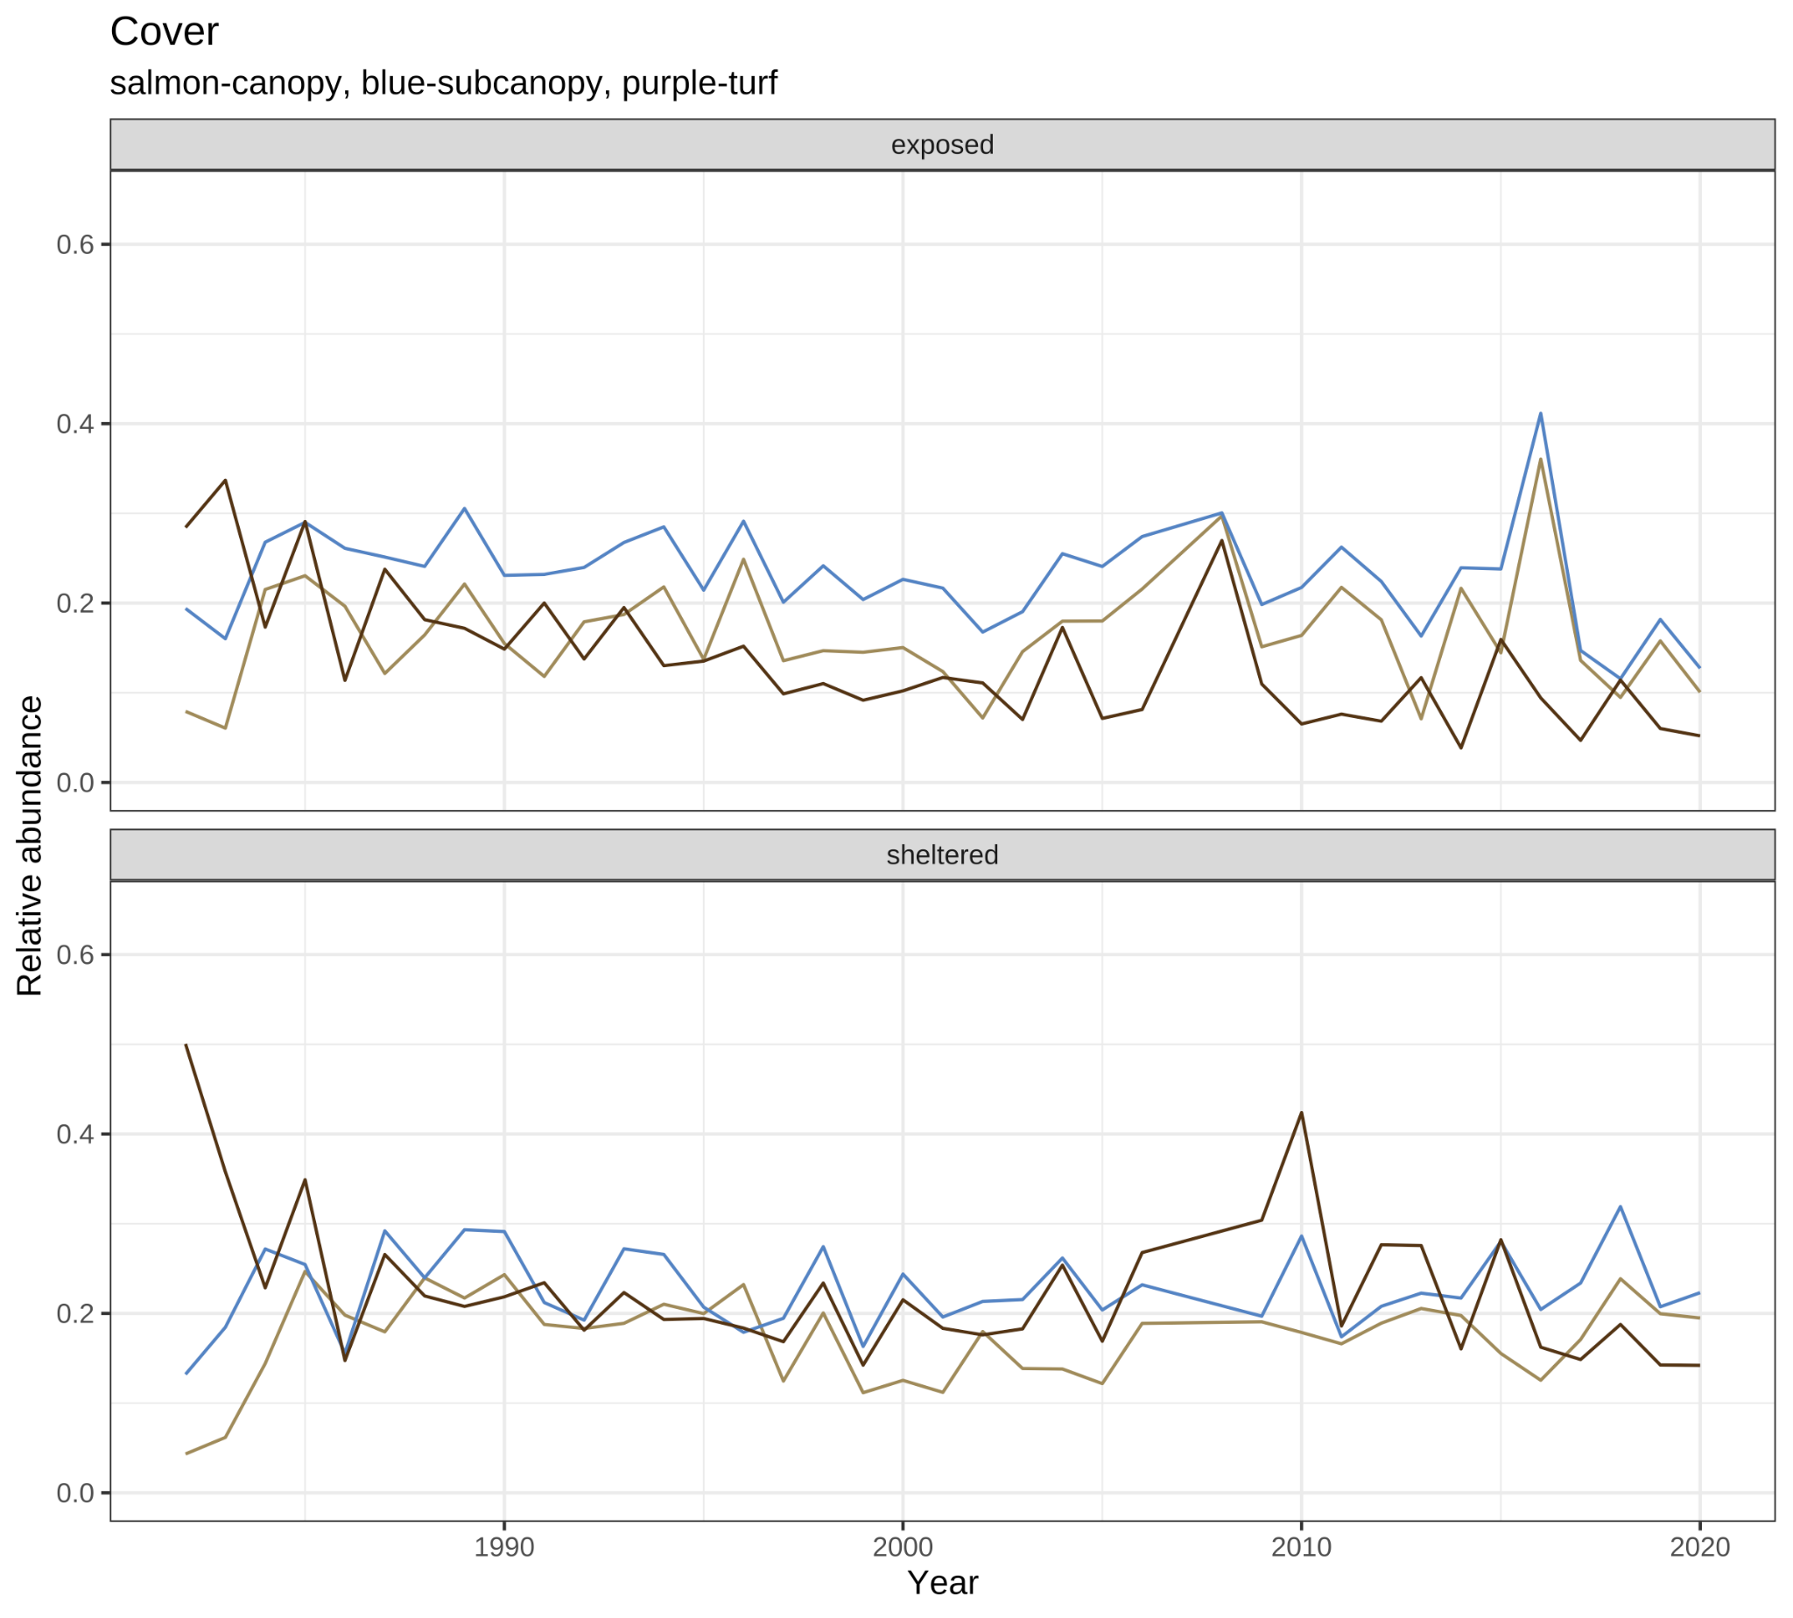
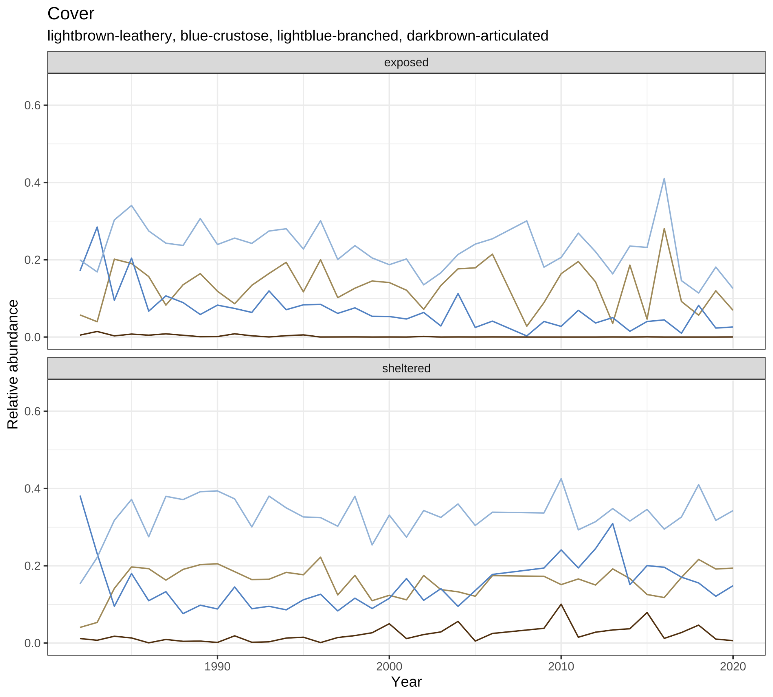
Algal traits did not show a strong trend
Morphology: Branched
Crustose
Leathery
Articulated
Vertical space:
Canopy
Subcanopy
Turf
Exposed
Exposed
E
E
Protected
Protected
Percent cover data: relative abundance

Slide 27
So how did Appledore change?
Red & filamentous algae
Urchins
Mesopredators
Notes:
Expectations from each:
Algae: not much is eating algae but littorina; can shelter predators in the lower intertidal and inverts from extreme weather in upper intertidal.

Slide 28
So how did Appledore change?
Change on the exposed side limited by the environment; Protected side from predators such as rock crab & dogwhelk
Notes:
Expectations from each:
Algae: not much is eating algae but littorina; can shelter predators in the lower intertidal and inverts from extreme weather in upper intertidal.

Slide 29
High variation in animal traits post-2010
Something new is happening to ecosystem function now.
Red & filamentous algae
Urchins
Mesopredators
Notes:
Expectations from each:
Algae: not much is eating algae but littorina; can shelter predators in the lower intertidal and inverts from extreme weather in upper intertidal.

Slide 30
Animals|Algae: similar pattern, different degree
Animals and Algae demonstrated similar pattern of more change in trait space on the protected side -- but the change was more marked for animals, driven by an increased impact of predators and an increased number of sessile filter feeding species.
In contrast, Algae morphological and space-use traits were generally stable over the time series.
Ecosystem function is changing for animals: More species of sessile filter feeders and more predators
Despite species turnover, algae are not experiencing the same degree of change in ecosystem function
Notes:
Expectations from each:
Algae: not much is eating algae but littorina; can shelter predators in the lower intertidal and inverts from extreme weather in upper intertidal.

Slide 31
Take-home
Protected vs exposed side | (>)Changed trait space | Changed trait space
 | (+) predators and (+) sessile filter feeding species. |  | Community shaping, Nutrient storage, trophic regulation ….
Notes:
We compiled a species-traits that represents species performance and fitness in marine ecosystems.

Slide 32
So how did appledore change?
Exposed vs protected had different patterns of change
Taxonomically: more new species on the protected side: 9 animals and 2 algae
Functionally: Larger change in functional trait fingerprint on protected side
Relative abundance count data shows more trait variation in the past 10 years, despite regime changes in the 90s
Relative abundance cover data shows some variation, but some algal morphology traits seem
Notes:
Functions: Crustose coralline algae contribute significantly to reef calcification and cementation, and they induce larval settlement of many benthic organisms.
Mean CCA cover is <1% on the inner third of the GBR, compared to >20% on the outer half of the shelf. CCA cover is also affected by the amount of sediment deposited, water clarity, and the steepness of the reef slopes. Within each cross-shelf zone, the cover of CCA is higher on reefs with low sediment deposits than on reefs with high levels of sedimentation. On the inner third of the shelf, the most sediment-exposed reefs are unsuitable habitats for most CCA. This inverse relationship between CCA and sediment has implications for the recruitment of CCA-specialised organisms, and for the balance between reef accretion and erosion.
Details of this study are published in Fabricius and De'ath (2001).
he predominant members of this functional indicator group tend to be slow-growing, com- petitively subordinate taxa that are abundant in most reef systems. As an indicator group they are functionally resilient and able to expedite the recovery and restoration of coral reef systems relatively quickly since some thin forms of crustose coralline algae accelerate colonization and chemically attract and facilitate the survival of coral larvae; the other two fleshy algal functional indicator groups (i.e., turfs and macroalgae) tend to overgrow and inhibit coral settlement, survival, and recovery

Slide 33
Implications
Functional traits can help us advance our understanding of the emergent changes occurring in marine communities and link changes in structure to potential effects on ecological function.
Studying functional diversity allows us to generalize the functional contributions of species to ecosystems and contemplate the potential ecological consequences of their extinction
This is critical to better comprehend the generalities of the vulnerability of marine benthic communities under ongoing and predicted global environmental changes.
Notes:
Functions: Crustose coralline algae contribute significantly to reef calcification and cementation, and they induce larval settlement of many benthic organisms.
Mean CCA cover is <1% on the inner third of the GBR, compared to >20% on the outer half of the shelf. CCA cover is also affected by the amount of sediment deposited, water clarity, and the steepness of the reef slopes. Within each cross-shelf zone, the cover of CCA is higher on reefs with low sediment deposits than on reefs with high levels of sedimentation. On the inner third of the shelf, the most sediment-exposed reefs are unsuitable habitats for most CCA. This inverse relationship between CCA and sediment has implications for the recruitment of CCA-specialised organisms, and for the balance between reef accretion and erosion.
Details of this study are published in Fabricius and De'ath (2001).
he predominant members of this functional indicator group tend to be slow-growing, com- petitively subordinate taxa that are abundant in most reef systems. As an indicator group they are functionally resilient and able to expedite the recovery and restoration of coral reef systems relatively quickly since some thin forms of crustose coralline algae accelerate colonization and chemically attract and facilitate the survival of coral larvae; the other two fleshy algal functional indicator groups (i.e., turfs and macroalgae) tend to overgrow and inhibit coral settlement, survival, and recovery

Slide 34



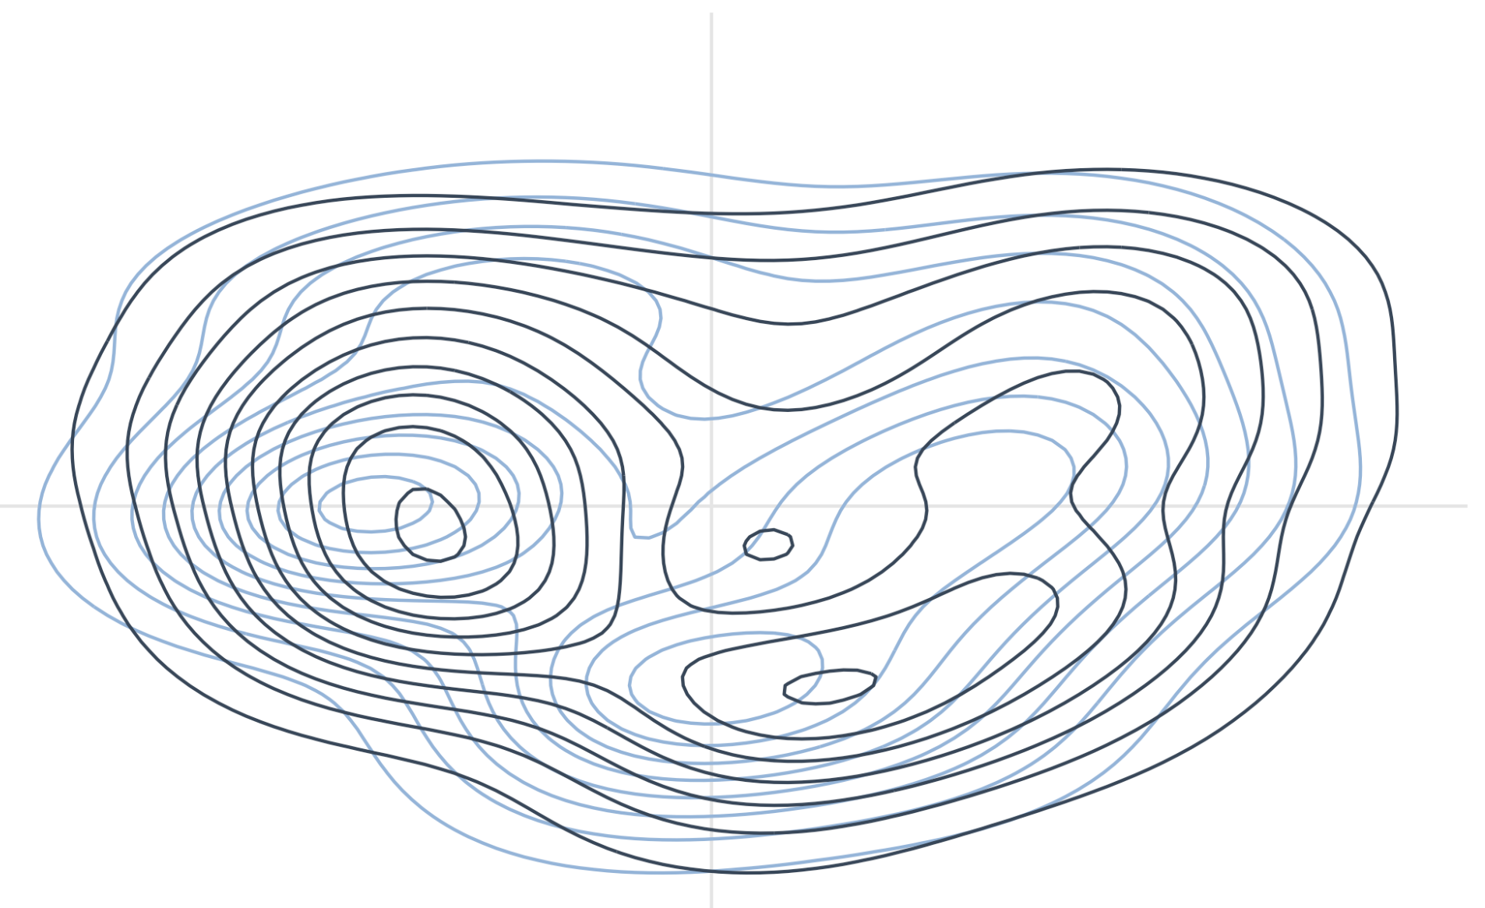





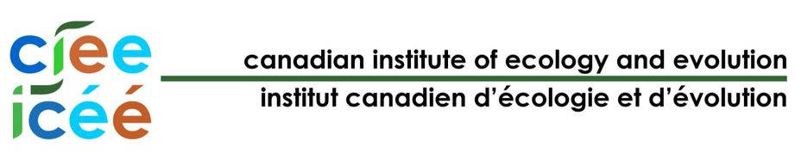
Acknowledgments

